Slide 1

Elder Law Boot Camp
Notes:
Clear Slide
Minutes Per Slide:________

Slide 2

Welcome to Brian M. Douglas & Associates, LLC
900 Circle 75 Parkway, Suite 800• Atlanta, GA 30339
770-933-9009 • www.BrianDouglasLaw.com
Notes:
Introduce team and how important everyone is
Minutes Per Slide:________

Slide 3

Why Elder Law Boot Camps?
Notes:
- Explain the origin of HC BC (Friends asked for credits)
- Created HC and FA BCs (did for several years, twice a year) Now both FA and HC are 6 Credit Hours
- Way to give back
- Give a little insight into elder law and how it affects professionals in their fields
Minutes Per Slide:________

Slide 4

Meet the Presenters: Brian M. Douglas
Brian attended Marquette University in Milwaukee, Wisconsin, where he studied mechanical engineering. He completed his degree in only four years, not the average 4.5-5 years it typically takes, all while working full time as a third-shift manufacturing supervisor for 110 employees in an international manufacturing company. After graduation, Brian moved to Atlanta and began attending John Marshall Law School. He graduated cum laude and was his class’s valedictorian.
Brian’s areas of expertise include estate planning, real estate, probate, Medicaid, business planning, and more. He has written an international best-selling book called, Plan Your Estate Before It’s Too Late. He also teaches real estate classes and does many speaking events in and around the Atlanta area.
Notes:
Give my purpose
- Show why it’s important to what we do
- It’s all about the family
Minutes Per Slide:________

Slide 5
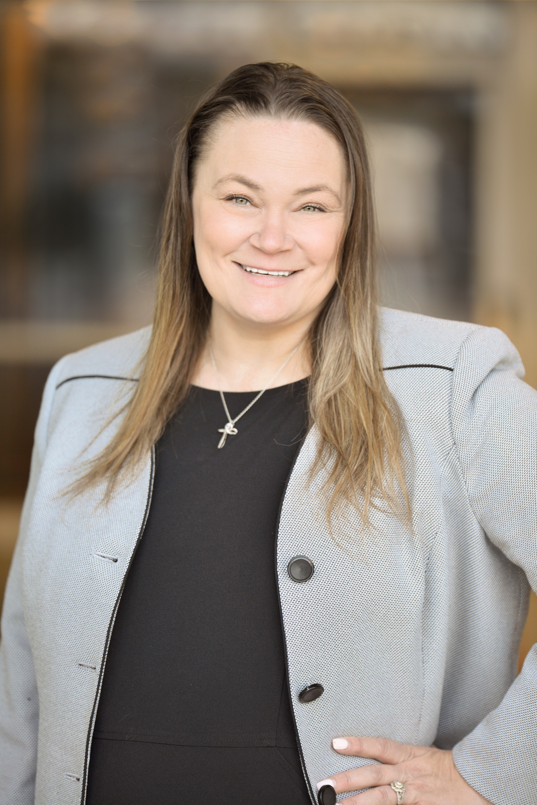
Meet the Presenters: Kimberly M. Partain
Since earning her bachelor’s degree from the University of Georgia and her Juris Doctor degree from the University of Alabama School of Law, Kimberly M. Partain has gone on to assist clients with business formation, estate planning, long-term care planning and special needs planning for over 17 years. Kimberly has trained and educated attorneys across the nation in Elder Law, Medicaid Planning, Special Needs Planning, and Trust Law.
Kimberly was a 5-time champion and Ambassador for the National Alzheimer’s Association and is proud to have lobbied in Washington D.C. to have the Hope for Alzheimer’s Act unanimously voted into law. Kimberly is a member of the National Academy of Elder Law Attorneys and believes it is her mission in life “to help all people age with dignity”.
Notes:
Give my purpose
- Show why it’s important to what we do
- It’s all about the family
Minutes Per Slide:________

Slide 6
Case Study
Notes:
Go over Case Study Facts
Minutes Per Slide:________

Slide 7
Case Study
What stands out?
John’s Capacity is unclear
John’s Will leaves everything to grandson with Down’s Syndrome
John’s and Jane’s assets are owned separately
John’s pension has no survivor benefits
Uncertainty of how Medicaid will affect Jane and the family
Jane’s Will names first husband to receive all of her assets
Handouts: Boot Camp Case Study; Boot Camp Case Study Facts; Medicaid Application Questionnaire
Notes:
Handouts:
Boot Camp Case Study → story of Jane & John Doe’s current conditions
Boot Camp Case Study Facts → Jane & John Doe’s Asset chart, questions to consider
Medicaid Application Questionnaire → personal & medical data, monthly income, monthly cost of nursing home, other monthly expenses, assets/liabilities, life insurance, gifts
Go over Case Study Facts
Minutes Per Slide:________

Slide 8
Estate planning
Notes:
Clear Slide
Minutes Per Slide:________

Slide 9

Questions to ask about Estate Planning
  What is it?
  Why do we need it?
  What do we need?
Notes:
Clear Slide
Minutes Per Slide:________

Slide 10
What is Estate Planning?
Definition of Estate Planning
  I want to CONTROL my property while I’m alive & well
  Plan for me and my loved ones if I become disabled
Notes:
What is estate planning? Everybody’s definition is different??
STORY→ 2 sisters in WS
Sister 1 – mom in NH lose 457,000.37
Sister 2 – End of Life Decision
Traditional estate planning fails to deal with disability?
Vertical & Horizontal Planning
Disability: Old days: You lived, then died.
Were there nursing homes 30 years ago? Some! How about now?
You don’t die anymore – live disabled.
Advanced medicine prolongs life.
Doesn’t help mental life.
Traditional estate planning fails to deal with disability.
Control → Anybody want to give up control?
- My last name is ___________________
Minutes Per Slide:________

Slide 11

Estate Planning
Definition of Estate Planning
  Give what I have:
  To whom I want
  When I want
  The way I want
    And when I die, I want my assets to go to the people I love, without unnecessary cost or delay.
Notes:
Review this slide quickly–
Question: Does this definition meet your needs for estate planning?
So is this a good starting point for all of us
Minutes Per Slide:________

Slide 12
Estate Planning
The Legal Documents that Answer the Questions:
    Who is in control?
    Who gets the benefit?
    When?
Notes:
Clear Slide
Minutes Per Slide:________

Slide 13
Alive & Well
Who is in control?
Who gets the benefit?
When?
Notes:
Take for Granted.
We can only plan when we are alive and well
Minutes Per Slide:________

Slide 14
Incapacitated
Who is in control?
Who gets the benefit?
When?
Notes:
POA (not spouse)
Show difference between Health & Financial
Introduce Guardianship
Minutes Per Slide:________

Slide 15
Death
Who is in control?
Who gets the benefit?
When?
Notes:
Now who’s in control/access
Leave it for now that everything goes to Spouse
ASK: Who is in control?
Who gets benefits?
When?
Tell them we will come back to this
Minutes Per Slide:________

Slide 16

  Who Needs Estate Planning?
Handouts: What to Expect When You’re Expecting An Inheritance; Estate Planning At A Glance
Notes:
Handouts:
What to Expect When You’re Expecting An Inheritance → The purpose of Estate Planning, importance of discussing with parents/as a family, Estate Planning is for everyone
“According to a study done by Ameriprise Financial, the number one reason adult children don’t address estate planning with their parents is that they don’t feel it is their place to bring it up.”
Estate Planning At A Glance → document chart
Everybody!!!
Story of two hand test
-shows family is most important thing
Minutes Per Slide:________

Slide 17
The Planning Pyramid
Focuses on client goals
“Solutions” make planning easier
Exposes traditional planning as “upside down”
Notes:
STORY - Airplane story
YOU have to put yourself first.
You care more about your family than money.
Society told you money is important – but it is family.
WE NEED YOU TO TELL US HOW TO PROTECT THE FAMILY AND YOU
Minutes Per Slide:________

Slide 18
Me
Notes:
Make this big (sing me, me, me)
Set up room to say family
Minutes Per Slide:________

Slide 19
Me
Spouse
Notes:
Make joke about forgetting spouse
Minutes Per Slide:________

Slide 20
Family
Me
Spouse
Notes:
Now → Family is important
Minutes Per Slide:________

Slide 21
Family
$
Me
Spouse
Notes:
Of course we all want to accumulate $
Minutes Per Slide:________

Slide 22
Taxes
$
Family
Me
Spouse
Notes:
Can’t forget about taxes
Minutes Per Slide:________

Slide 23
Creditors
Taxes
$
Family
Me
Spouse
Notes:
Add creditors
Examples:
NH (10,000-12,000 month)
Car accidents
Divorce
Minutes Per Slide:________

Slide 24
Predators
Creditors
Taxes
$
Spouse
Family
Me
Notes:
Predators → may surprise you
Minutes Per Slide:________

Slide 25
Family
Predators
Creditors
Taxes
$
Me
Spouse
Me
Notes:
Show that this is how most people come into out office
- worried about $$/taxes
We need to flip it right side up
Minutes Per Slide:________

Slide 26
Predators
Creditors
Taxes
$
Spouse
Family
Me
Notes:
Focus on family
- You and then your family
Minutes Per Slide:________

Slide 27

What Do They Need?
2 Finger Test
Is a simple Will enough?
Is a simple POA good enough?
Notes:
Who has heirs? Who has disabled heirs? Who has minor heirs?
Nope! Heirs are not determined until death.
2 Finger Test: Tell me when you will die
No idea
Is simple Will enough: Psychic story
Special Needs Trust, Understated Age Trust
Is POA good enough: STORY- saved $75
Minutes Per Slide:________

Slide 28
Pre-planning
Crisis Planning
Notes:
Introduce Concept of V
Pre Planning vs. Crisis Planning
Pre Planning
- POA (make sure that it has all powers)
- Trust
Minutes Per Slide:________

Slide 29
Pre-planning
Crisis Planning
Trusts/POA
Notes:
Show how roads don’t cross, once you complete TNST you hope to make it 5 years
Once we start w/ TNST, if person falls ill we need to come back to beginning
Minutes Per Slide:________

Slide 30
Trust
Notes:
If we do Trust and do not make it full 5 years, we have a decision to make:
More than 5 years → 100%
4 years → 90% +/-
3 years → 75-80% +/-
Minutes Per Slide:________

Slide 31
Pre-planning
Crisis Planning
Trusts/POA
Guardianship
Medicaid crisis
VA
Notes:
Clear Slide
Introduce Crisis
Minutes Per Slide:________

Slide 32
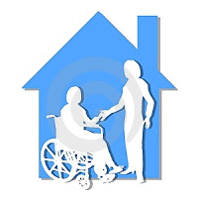
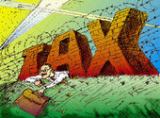

3 Lands
Tax Land
Long Term Care Land
Estate Planning Land
Notes:
Tax:
Child’s name alone; joint → Show in all 3 lands
EP:
Introduce Trust → in control
– Walk through all 3 lands
– Show how connected & how different
Then walk through joint owned from all 3
– Show what happens in all
Minutes Per Slide:________

Slide 33
prE-planning
Managing Incapacity, Advance Directives, Wills, and Trusts
Notes:
Clear Slide
Minutes Per Slide:________

Slide 34
Managing incapacity
Notes:
Clear Slide
Minutes Per Slide:________

Slide 35
Recognizing & Managing Incapacity
Legal definitions of capacity
Recognizing incapacity
Legal implications of dementia
Handouts: Legal Capacity Required Chart; Understanding the Four C’s of Elder Law Ethics
Notes:
Handouts:
Legal Capacity Required Chart → transactions and the legal capacity required
Understanding the 4 C’s of Elder Law Ethics → all lawyers are required to follow: client identification, conflicts of interest, confidentiality, competency
Statute- A testator must have testamentary capacity to make a valid will. Georgia law states that testamentary capacity exists “when the testator has a decided and rational desire as to the disposition of property.” GA Code § 53-4-11
In case law- expanded it to 3 part test (will)
1. Natural objects of bounty
2. generally what the estate consists of
3. Draw connection between 2 and what person wants to occur (even if impaired memory)
Guardianship- Read definition out of UCGA: "Adult unable to consent" means a person 18 years of age or older who has been determined in his or her medical records by a licensed physician after the physician has personally examined the adult that he or she lacks sufficient understanding or capacity to make significant responsible decisions regarding his or her medical treatment or the ability to communicate by any means such decisions.
Incapacitated individuals are adults whose abilities to receive and evaluate information effectively and to communicate decisions in any way are impaired to such an extent that they are partially or totally unable to meet the essential requirements for their physical health and safety.
POA- Go over handout on capacity from PBI (reference handout)
Recognizing Incapacity
Talk from experience- in our office we need to know if person has capacity or not. Usually we can ascertain within seconds
*Reference 4 C’s handout*
In gray area (tough)
Atty asks questions to ascertain capacity
May use mini mental exam
May send to Dr. to get opinion letter
Licensed psychologist- want to know if they have legal capacity to sign documents (often insurance companies will pay for this)
Legal Implications- Just because person has dementia diagnosis does not mean that they don’t have legal capacity (lucid in the moment)
Minutes Per Slide:________

Slide 36
All disability types (hearing, vision, cognitive, ambulatory, self-care, and independent living) have increased in disability percentages with age. [In the US in 2015] for people ages 65 and older, 35.4% had a disability.
[Kraus, Lewis. (2017). 2016 Disability Statistics Annual Report. Durham, NH: University of New Hampshire.]
Notes:
Clear Slide
Minutes Per Slide:________

Slide 37
Power of Attorney: In-Depth
Execution
    Witnesses (2)
    Notarized
Notice
Agent Acknowledgment
Presumed durable
Special rules for gifts
Specifying powers
Revocation
Third party liability
Third party immunity
Compensation
Out-of-State POAs
Handout: Jeff’s 7 Tips for Better POAs
Notes:
Handout:
Brian’s 7 Tips for Better POAs → (1) watch the basics, (2) select the right agent, (3) have the right gifting powers, (4) authorize agent to create trusts for others, (5) give authority over digital assets, (6) store it properly, (7) make it effective
Notice and acknowledgment have changed as of July 1, 2017 –
– if POA meets the old one then it is grandfathered in (made prior to July 1, 2017)
Explain why GA Uniform POA Act came into place (providing protection for banks and institutions accepting POAs
– If they believe in good faith the document is valid the bank will be protected
Durable – means that document is effective through incapacity (now deemed to be durable unless otherwise stated)
Gifting powers must be expressly provided for
Specifying powers (hot powers in new statute)
– changing beneficiary designations
– we have to explain in meetings what powers are and why they may or may not want them
Revocation – can always revoke as long as have capacity
– same definition of creating POA
GA Uniform POA Act protections for banks and 3rd parties
– If you provide a validly executed document to 3rd party and they do not accept it they can be sued
– If they accept a document believing it is valid they cannot be sued (if in good faith)
Compensation – reasonable
If document says none agent can always get costs
Out of state POA – if valid in state created in then valid in our state
– But many banks concerned about liability and may find reasons not to accept
Minutes Per Slide:________

Slide 38
Guardianship Process
Petition
Hearing
Medical testimony
Attendance of dalleged incapacitated dperson
Contested, uncontested
Bonding & annual reports
Petitions
Emergency Guardianship
Handouts: Petition for Appointment of Guardian; Emergency Admission Process Map; Protecting Mom & Dad’s Money
Notes:
Handouts:
Petition for Appointment of Guardian, Notification of Mental Health Commitment, Protecting Mom & Dad’s Money
Explain the process of guardianship
If we have POA we can avoid the guardianship process
York County website –
GREAT resource
Bonding – must have bonding in place ahead of time
Annual reporting (York has great website with forms)
Emergency guardianships – Emergency guardianship order appointing an emergency guardian of the person may be in effect for up to 72 hours. If the emergency continues, the emergency order may be extended for no more than 20 days from the expiration of the initial emergency order
– Still have to attend the guardianship hearing
Minutes Per Slide:________

Slide 39
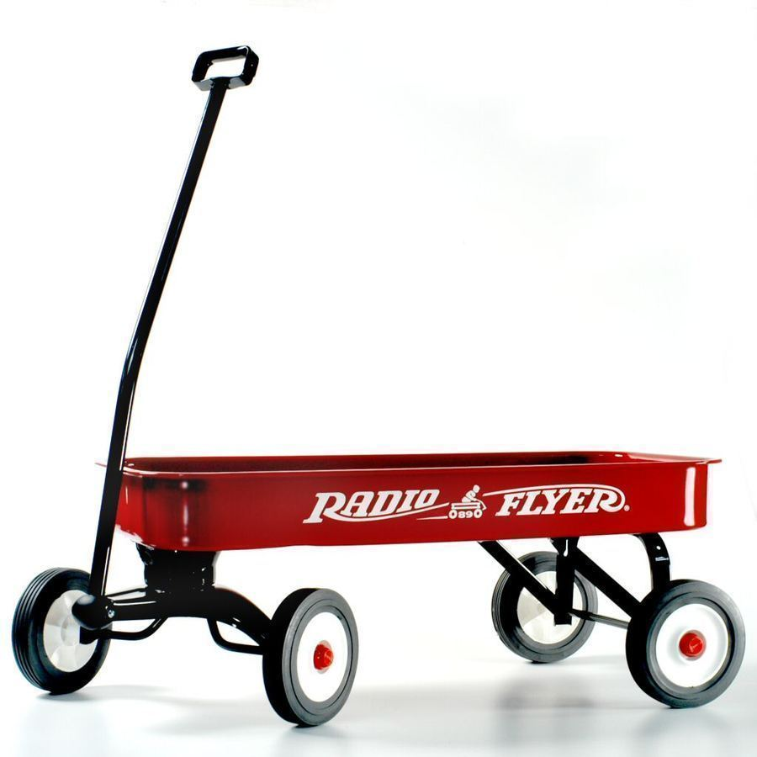
Using a Trust
Managing incapacity
Trustee & successors
Notes:
Give brief overview of what trust is (contract between 3 parties) (grantor, trustee, beneficiary)
Red Wagon – Your own rule book
Disability panel
Trust protector
Family is in control and not the courts
Minutes Per Slide:________

Slide 40
Civil Commitment
Voluntary
Involuntary “302”
Notes:
Voluntary – § 37-3-20 - Admission of voluntary patients; consent of parent or guardian to treatment; giving notice of rights to patient at time of admission. ... The parents or guardian of a minor child must give written consent to such treatment. An individualized service plan shall be developed for such person as soon as possible.
Involuntary - § 37-3-83 To commit someone involuntary for a mental evaluation, two people have to petition the Court. Petitioners must have witnessed the behavior of an individual within 48 hours of their hearing date. If it has been 49 hours since the two individuals saw the mentally ill person, the Judge cannot sign the Order to Apprehend.
Must show that the person being committed is a clear and present danger to himself and/or others
Clear and present danger to himself may be shown by establishing that within the past 30 days;
The person has acted in such a manner as to evidence that he would be unable, without care, supervision and the continued assistance of others, to satisfy his need for nourishment, personal or medical care, shelter or self protection and safety and that there is a reasonable probability that death, serious bodily injury or serious physical debilitation would ensue within 30 days unless adequate treatment were afforded under this act; or;
ii) The person attempted suicide and that there is a reasonable probability of suicide unless adequate treatment is afforded under this act.
iii) The person has mutilated himself or attempted mutilation….
Minutes Per Slide:________

Slide 41

Protecting Against Exploitation
Warning signs
Social
Financial
Legal
Handouts: Protecting Mom & Dad’s Money; Lies, Secrets, and Scams: How to
Prevent Elder Abuse; Shining a Spotlight on Elder Abuse; 5 Things Everyone
Should Know About Elder Abuse
Notes:
Handout:
Protecting Mom and Dad’s Money → elder financial abuse issues, multiple stories/examples of how elders have been taken advantage of, how to protect yourself
Lies, Secrets, and Scams: How to Prevent Elder Abuse → in-depth stories of financial elder abuse, signs of financial elder abuse and scamming patterns, the emotional games and altered reality of abuse
“The amount lost to swindlers, whether they are strangers or even relatives, is huge, with estimates ranging from almost $3 billion to more than $30 billion annually.”
“Among the factors that keep seniors from reporting scams are deep humiliation once they realize they’ve been had, and fear of reprisals from scammers who may have made threats to keep them silent.”
Shining a Spotlight on Elder Abuse → overview of all types of elder abuse (physical, sexual, emotional, confinement, passive neglect, willful deprivation)
“Too often, elder abuse goes unreported and untreated. One study estimates that only 1 in 14 cases of abuse are reported to authorities.”
5 Things Everyone Should Know About Elder Abuse → it’s bigger than you might think, some caregivers may be unaware of the abuse, some older adults become more vulnerable as their brain changes, prevention methods are lacking, collaboration is key
“1 in 10 Americans over 60 years old has experienced some form of elder abuse...”
Discuss – POA and guardianship
Minutes Per Slide:________

Slide 42
“1 in 10 Americans over 60 years old has experienced some form of elder abuse...”
“Too often, elder abuse goes unreported and untreated. One study estimates that only 1 in 14 cases of abuse are reported to authorities.”
“The amount lost to swindlers, whether they are strangers or even relatives, is huge, with estimates ranging from almost $3 billion to more than $30 billion annually.”
“Among the factors that keep seniors from reporting scams are deep humiliation once they realize they’ve been had, and fear of reprisals from scammers who may have made threats to keep them silent.”
Notes:
Clear Slide
Minutes Per Slide:________

Slide 43
Advance directives
Notes:
Clear Slide
Minutes Per Slide:________

Slide 44
Definitions
Health Care Power of Attorney
Living Will
Advance Health Care Directive
Handout: Tom Petty and Your End-of-Life Wishes
Notes:
Handout:
Tom Petty and Your End-of-Life Wishes → tragic events can happen no matter the age or health, importance of stating preferences
“While more than 70 percent of Americans want to die at a home in a familiar, comfortable setting, only 25 percent do so.”
“90 percent of people say talking with their loved ones about end-of-life care is important, but only 27 percent have actually done so.”
Define what a health care POA is
– when is it valid
– when does it cease
Death
or; when Living Will kicks in
Minutes Per Slide:________

Slide 45
Define: End Stage Medical Condition
Incurable & irreversible medical condition
In an advanced state
Caused by injury, disease, or physical illness
Physician's opinion (to a reasonable degree of medical certainty)
Will result in death
Despite the introduction or continuation of medical treatment
Notes:
Living will – permanently unconscious, terminally ill, vegetative, comatose 2 qualified physicians state that there is no realistic hope of recovery
Minutes Per Slide:________

Slide 46
End Stage Medical Condition
BUT
Term does not preclude treatment (even if the disease/illness is incurable, regardless of its severity)
Patient will benefit from the medical treatment, including palliative care
Treatment will not merely prolong the process of dying
Patient directs otherwise in his or her Advance Health Care Directive
IF
AND
UNLESS
Notes:
Clear Slide
Minutes Per Slide:________

Slide 47
Define: Life Sustaining Treatment
Any medical procedure or intervention
When administered to a patient or principal in an end-stage medical condition
Which will serve:
        Only to prolong the process of dying
        OR maintain the individual in a permanent istate of unconsciousness
Notes:
Clear Slide
Minutes Per Slide:________

Slide 48

Types of Advance Directives
Health Care Directive
    Durable Health Care Power of Attorney
    PLUS
    Living Will
DNR/Out of Hospital DNR
Informal Health Care Decision Making
Notes:
Taken together LW and HCPOA provide more information than POLST form, including but not limited to details about health care agent, more complete health care wishes and preference for organ donation
Minutes Per Slide:________

Slide 49
 | HCPOA | LW | DNR | ADHC
Who may create? | 18+, emancipated minor Capacity | 18+, emancipated minor Capacity | Individual with end stage medical condition or their HC representative | 18+, emancipated minor Capacity
Who must sign? | Principal | Principal | Physician | Principal
Who may revoke? | Principal with capacity | Principal with or without capacity | Principal with or without capacity | Principal with or without capacity
When effective/ implicated? | Immediately or upon incapacity | End-stage medical condition only | When cardiac or respiratory arrest | End-stage medical condition and EMS are involved
Binding on medical personnel? | Yes* (provider may object) | Yes* (provider may object) | Yes | Yes* (provider may object)
Binding on emergency personnel? | No | No | Yes (out of hospital DNR) | No
Notes:
Clear Slide
Minutes Per Slide:________

Slide 50
Who Makes Decisions?
 | End Stage Medical Condition | Life Threatening, but treatable | General HC Decisions
Patient | Yes | Yes | Yes
Health Care Agent | Yes | Yes | Yes
Guardian | Yes | Yes | Yes
Notes:
Minutes Per Slide:________

Slide 51
Issues with Advance Directives
Compliance
Revocation
Countermanding decisions of the agent
Handout: Adults of Every Age Should Have Advance Health Care Directives
Notes:
Handout:
Adults of Every Age Should Have Advance Health Care Directives → importance of everyone over 18 having an advance HCD
Quiz from Andy on Living Wills (Adults of Every Age…)
Walk through Handout and ask questions
Minutes Per Slide:________

Slide 52
MORNING DEBRIEF
What stood out for you?
What do you want to remember?
What surprised you?
General comments
Notes:
Clear Slide
Minutes Per Slide:________

Slide 53
Do I need a will or a trust?
How do you own your assets?
Handout: Horror Stories: When You Die Without a Will
Notes:
Handout:
Horror Stories: When You Die Without a Will → great, short examples of how things can go wrong
“Nearly three-quarters of Americans don’t have a will or don’t have one that’s up to date: 63% do not have a will at all, and another 9% percent have a will that is out of date, according to a Google Consumer survey by USLegalWills.com.”
“Among seniors age 65 and older, only half have up-to-date wills in place.”
*Great stories in this article*
Walk through handout and ask questions
Minutes Per Slide:________

Slide 54
How do you own your assets?
YOU
SPOUSE/BENEFICIARY
Joint
Beneficiary Designation
Annuity
Insurance
401(k)/IRA
RLT
“POD”
“TOD”
“ITF”
Will
Your name alone
Notes:
Story:
Biff the Pool Boy
Car Accident (School Bus)
Stroke and in home NH
World’s best trust and world’s best Will.
Show all assets and how they go right over to the benie and not to the world’s best Will or trust.
Will or trust didn’t do anything.
By benie designations I bypassed the entire thing.
Now, I have to hope whoever got it won’t be sued, divorced.
Minutes Per Slide:________

Slide 55
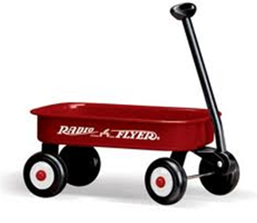
How do you own your assets?
YOU
SPOUSE/BENEFICIARY
Joint
Beneficiary Designation
Annuity
Insurance
401(k)/IRA
“POD”
“TOD”
“ITF”
Notes:
Discuss importance of funding
How do we put assets in Wagon
Mom story
Getting money out
Firing Dad
Remarriage protection
Minutes Per Slide:________

Slide 56
Comprehensive Plan
Ties Goals into Plan
Will
Probate
Trust
Funding
Notes:
All must tie together
Benies must be correct and pointed to correct place
Make sure they don’t contradict each other
Make sure funding of all assets is correct
Minutes Per Slide:________

Slide 57
What is a trust?
Different Types and How They Work
Notes:
Clear Slide
Minutes Per Slide:________

Slide 58
What is a Trust?
A contract between three parties
    Grantor—Creator
    Trustee—Controller
    Beneficiary—Receiver
Notes:
What do you want to be?
Benie
Trustee
Grantor
NO → ALL 3
Give brief overview of Tax Trust & how they are different
- Tax Trust vs Grantor Irrevocable Trust
Minutes Per Slide:________

Slide 59
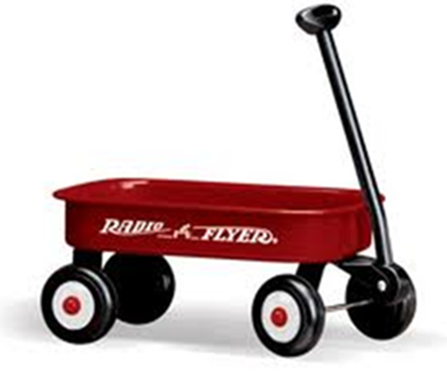
Two Types of Trusts:
Testamentary
    In Will (needs probate)
Living Trust
    create when “living”
        Revocable
        Irrevocable
    In place of Will (avoids probate)
Notes:
Trust is contract between grantor, trustee and beneficiary.
You can be all three.
Testamentary: You must die and must probate.
QUESTION: How effective is it if you become disabled mentally?
EXPLAIN TRUSTS AND WHAT YOU CAN CONTROL
RLT – Open box – explain.
IRR – Closed box – explain.
Can’t change it – wrong (tax issues) (I told you – you’d answer wrong).
Give up irrevocably the right to something.
Give examples:
Five-year trust.
Income only.
Wagon Story
Minutes Per Slide:________

Slide 60

Key to an Effective Estate Plan
Control of Process
Proper Asset Ownership
Notes:
The key is for you to maintain control of the process!! From the beginning because
Under probate who is in control?? Probate, lawyers, state rules.
How do we get control? The trust concept? A trust is a little red wagon?? With your own rule book? Your rule book will probably make things easier than the state’s rule book. We help you build it.
STORY – CARRY ALL YOUR BOXES – Imagine your Stuff is boxes. So we have to make sure we get your boxes in your wagon – proper asset ownership. What happens when you die or become disabled with your rule book of instructions…..?
Control is not the Courts and lawyers its you and your family.
This is important because a Trust never dies, trust never becomes disabled.
That’s why we want to put our assets into a trust –
How do you know you own an account?
Trustee controls accounts. Does not own.
“Estate Planning Trusts”
Plan for while you are alive.
Do you lose control of assets? Explain control of process.
Control is not the Courts and lawyers its you and your family.
Your Rule Book.
Minutes Per Slide:________

Slide 61
What is a Grantor Trust?
Trust that remains in person’s SS #
Trust that tax consequences flow llthrough to the Grantor
Grantor controls (can be trustee)
Included in Grantor’s Estate (control)
Notes:
Clear Slide
Minutes Per Slide:________

Slide 62
What is a Non-Grantor Trust?
Trust that must obtain a new Tax ID #
Trust that must file trust tax return
    Pay higher tax rates
Grantor cannot be trustee
Notes:
Used for Tax planning and VA planning
Minutes Per Slide:________

Slide 63
Grantor vs. Non-Grantor
RLT (Revocable Grantor Trust)
Asset Protection (Irrevocable Grantor Trust)
VA (Irrevocable Non-Grantor Trust)
Tax Planning (Irrevocable Non-Grantor Trust)
Notes:
Clear Slide
Minutes Per Slide:________

Slide 64
Revocable Trust
Control
    All Income
    All Principal
    (All Subject to loss)
(NO Asset Protection)
WHY? → Probate Avoidance
Notes:
Remind them of Debtor Creditor Law → Creditors have direct access to whatever debtor has direct access to
Susan Ormand Story
(NO AP)
– some states are very difficult to go through Probate
– very expensive (not to expensive I GA if uncontested)
Show what has to be done for Probate admin. vs Grantor Trust admin.
(only difference is executor going to courthouse to take oath)
Cost in GA to Probate an estate is on average: $4,000 (including attorney fees for a smaller estate). Everything in Probate is based on the value of the estate, so it is a range more than a set fee.
Minutes Per Slide:________

Slide 65
Trust Types
Irrevocable Trust for Tax Purposes
    No Control
    No Income
    No Principal
(None Subject to Loss)
For people with more than _______
(per person)
Notes:
Explain why these types of trusts aren’t good. No one wants to do them but ours can be different if we aren’t facing huge tax issues and we are doing complete estate planning.
Federal Exemption Amount Changes Every Year: 11.7 million (2021)
Can’t accomplish what we defined earlier as our definition of Estate Planning.
Go to next slide
Minutes Per Slide:________

Slide 66
Trust Types
Irrevocable Trust for VA Purposes
    No Control
    No Income
    No Principal
(None Subject to Loss)
For Veterans to get Aid & Attendance
Notes:
Explain why these types of trusts aren’t good. No one wants to do them but ours can be different if we aren’t facing huge tax issues and we are doing complete estate planning.
Can’t accomplish what we defined earlier as our definition of Estate Planning.
Go to next slide
If veteran wants this benefit (only choice) often downsides of non-grantor trust are worth it to get $ income every month.
Minutes Per Slide:________

Slide 67












REVOCABLE vs IRREVOCABLE
TRUSTS
REVOCABLE
IRREVOCABLE
Terms CAN be Changed
WHAT
Terms CAN’T be Changed
BENEFICIARY
CAN BE CHANGED
CAN’T BE CHANGED
ASSETS
CAN BE CHANGED
CAN’T BE CHANGED
GRANTOR’S ESTATE
ASSETS INCLUDED
ASSETS EXCLUDED
USES
SIMPLER
THAN A
WILL
PLAN FOR
MENTAL
DISABILITY
PROTECTION
FROM
CREDITORS
PRIVATE
VS
TAX
DEDUCTIONS
MEDICAID
PLANNING
Notes:
Clear Slide
(discuss from high level)
Minutes Per Slide:________

Slide 68
Review of Estate Planning
I want to control my property while I’m halive and well
Plan for me and my loved ones if I hbecome disabled
Notes:
Remember our definition of EP
- (Control is key)
Minutes Per Slide:________

Slide 69

Trust Types: Income Only Trust
Income Only Trust
    Some (All?) Control
    All Income
    No Principal
    (Income Subject to Loss)
Notes:
REINFORCE THESE CONCEPTS: Now, come into my world.
These trusts provide personal instructions upon your death, asset protection during your life, and allow you to leave money to your loved ones in cases of serious long term care in a nursing home.
Remember all of our stories….. Let’s go over the income only trust
You are convinced once you give up right to principal you will need it even though you have never spent it. So let’s discuss this….
What if you need it? We are okay! You gave away principal but you can give it to anyone except you or spouse. Give it to kids and then have them gift it back to you. If not, they won’t get anything else.
What if child gets weird? It is okay, there is a trap door. Still have AP
Minutes Per Slide:________

Slide 70
Trust Types: Income Only Trust With Children as Income Beneficiary
Income ONLY Trust for Family
    Some (All?) Control
    No Income
    No Principal
    No Income or Principal Subject to Loss
Notes:
REINFORCE THESE CONCEPTS: Now, come into my world.
These trusts provide personal instructions upon your death, asset protection during your life, and allow you to leave money to your loved ones in cases of serious long-term care in a nursing home.
Remember all of our stories….. Let’s go over the income only trust
You are convinced once you give up right to principal you will need it even though you have never spent it. So let’s discuss this….
What if you need it? We are okay! You gave away principal but you can give it to anyone except you or spouse. Give it to kids and then have them gift it back to you. If not, they won’t get anything else.
What if child gets weird? It is okay, there is a trap door. Still have AP
Minutes Per Slide:________

Slide 71
Why Families choose
Income only trusts
Notes:
Give examples of clients using both
Minutes Per Slide:________

Slide 72

Let’s see how ownership affects your will, trust, or other estate plan!
Notes:
Clear Slide
Minutes Per Slide:________

Slide 73
How do you own your assets?
YOU
SPOUSE/BENEFICIARY
Joint
Beneficiary Designation
Annuity
Insurance
401(k)/IRA
Revocable Trust
“POD”
“TOD”
“ITF”
Individually Owned Assets
Trust in Will
or
Stand-Alone Trust
Your name alone
Notes:
REMINDER: This slide appeared earlier (#53), so provide overview and move on.
Minutes Per Slide:________

Slide 74

How do you own your assets?
YOU
SPOUSE/BENEFICIARY
Joint
Beneficiary Designation
Annuity
Insurance
401(k)/IRA
“POD”
“TOD”
“ITF”
Individually Owned Assets
Will
Your name alone
Notes:
Discuss importance of funding
How do we put assets in Wagon
Mom story
Getting money out
Firing Dad
Remarriage protection
Minutes Per Slide:________

Slide 75
Notes:
Teach Vision Clarifier:
– Why important
– How it is used
– Uniformity
- Advantage to clients and referral sources
Minutes Per Slide:________

Slide 76


Provides protection of assets while you are alive, while still allowing you control over your assets
ALL CONTROL
ALL INCOME OUT OF TRUST
NO PRINCIPAL?
OR
ALL CONTROL
NO INCOME OUT OF TRUST?
NO PRINCIPAL?
AP Trust
Notes:
Remind them of difference between MIT and FIT (why they are used)
Use boxes as demonstration
Minutes Per Slide:________

Slide 77
Irrevocable Grantor Trust
Income Only Trust
Income Only Trust to Family
    How would client know which they have?
      Look in trust at Lifetime Income Beneficiaries
      If grantor’s name is listed under income, then he/she has the right to income
Notes:
Clear Slide
Minutes Per Slide:________

Slide 78
Income Only Trust
ARTICLE TWO
THE LIFETIME TRUST
During our lifetimes the Trustee shall hold all assets contributed to this Trust by us or others as a separate “Lifetime Trust” as set forth in this Article.
Section 2.01 Lifetime Trust Income Beneficiaries
The income beneficiaries of the Lifetime Trust created herein are as follows:
Name or Class | Relationship
Brian Douglas | Grantor
Tess Douglas | Grantor
Paige Douglas | Our daughter
Campbell Douglas | Our daughter
Reese Douglas | Our daughter
Shows Grantor Names (Brian & Tess Douglas) as Income Beneficiaries
Notes:
Clear Slide
Minutes Per Slide:________

Slide 79
Income Only Trust - Family
ARTICLE TWO
THE LIFETIME TRUST
During our lifetimes the Trustee shall hold all assets contributed to this Trust by us or others as a separate “Lifetime Trust” as set forth in this Article.
Section 2.01 Lifetime Trust Income Beneficiaries
The income beneficiaries of the Lifetime Trust created herein are as follows:
Name or Class | Relationship
Paige Douglas | Our daughter
Campbell Douglas | Our daughter
Reese Douglas | Our daughter
Does NOT Show Grantor Names (Brian & Tess Douglas) as Income Beneficiaries
Notes:
Clear Slide
Minutes Per Slide:________

Slide 80
How does this trust work?
How do we get Asset Protection with tithis trust?
    Debtor-Creditor Law
Notes:
Debtor-Creditor Law → whatever debtor has direct access to so does the creditor
Minutes Per Slide:________

Slide 81
Trustee
What can the trustee do?
What can’t the trustee do?
Notes:
Key → Can’t give $ directly to grantor or grantor’s creditors
Minutes Per Slide:________

Slide 82






TRUSTEE
WHO
PERSON GIVEN THE POWER
TO MANAGE & ADMINSTRATE
CHARITIES
OTHER THINGS
TRUST FUNDS
PENSIONS
WILLS
HOW IT WORKS
TRUSTEE
MANGES & DISTRIBUTES FUNDS
GRANTOR
ESTABLISHES THE TRUST
TRUST
ASSETS
BENEFICIARIES
RECEIVE INCOME
Notes:
Grantor = Settlor
(we use Grantor)
Minutes Per Slide:________

Slide 83
What You Must Remember with Asset Protection Trusts
Must have Assets titled in the name of tithe Trust
    ID—Brian Douglas trustee of the Douglas Family tTrust dated _________
Notes:
Clear Slide
Minutes Per Slide:________

Slide 84


Funding Your Trust
Notes:
Do demonstration from front of room
Minutes Per Slide:________

Slide 85


Notes:
Do demonstration
Minutes Per Slide:________

Slide 86

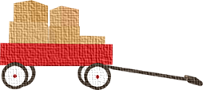
Notes:
Do demonstration
Minutes Per Slide:________

Slide 87
What You Must Remember with Asset Protection Trusts
Do not put retirement accounts in the titrust
Trustee can write checks of principal to tianyone on the world except…
Can add assets later (5 year look back)
Notes:
If retirement accounts are put in trust
→ triggers tax consequence
Minutes Per Slide:________

Slide 88
How Trusts Can Avoid Problems Posed By:
Second marriages
Heirs with disabilities
Spendthrift heirs
A widow(er)’s remarriage
Avoiding post-death family fight
Clark vs. Rameker
Other issues
Notes:
Spend a few minutes on see-through trusts
Clark vs. Remeker:
-Holding: funds held in inherited IRA are not “retirement fund” within meaning of USC section 522(b)(3)(c)
Walk through each one & give example in front of room
Minutes Per Slide:________

Slide 89
IRA can name trusts as beneficiary, and will be treated as a “see through” to the beneficiary of the trust
No income taxation upon funding and full IRA dstretch if properly done
Available to trust beneficiaries if 4 conditions kmet:
    Trust valid under state law
    Trust irrevocable at grantor’s death
    Must have all “natural” beneficiaries (danger!)
    Provide a copy of trust to plan administrator
Notes:
Clear Slide
Minutes Per Slide:________

Slide 90
Court’s Rationale of Holding
Under law, “retirement funds” are funds set aside for a day when one “stops working,” whereas inherited IRAs:
          Can never be contributed to
          Owners must withdraw fund, no matter how far they are from retirement
          Owners can withdraw any amounts “without penalty” at any time
Notes:
Spend a few minutes on see-through trusts
Minutes Per Slide:________

Slide 91
Beneficiary Designations
“My estate” → 5 year rule
“My children” → Oldest child
“My trust” → Oldest beneficiary in trust
“My family trust” → Oldest beneficiary in family trust
“The trustee under Article 8 of the JRB Trust f/b/o my fifchildren” → Oldest child
“1/3 to each trustee of the separate shares under ffiArticle 8…” → Each separate age
Handout: IRA Beneficiary Options
Notes:
Debtor-Creditor Law – whatever debtor has direct access to so does the creditor
Minutes Per Slide:________

Slide 92
How can advisors make inadvertent mistakes?
Not being comprehensive
Not tying plan together
Notes:
Clear Slide
Minutes Per Slide:________

Slide 93
Case study
Sally and Bob Hadda Baby
Notes:
Clear Slide
Minutes Per Slide:________

Slide 94

Sally and Bob Hadda Baby
Sally and Bob recently celebrated the birth of their son, Billy Bob. At the insistence of their family, they went to an estate planning attorney and had their estate planning documents prepared. In an abundance of caution, the family decided to put a testamentary trust in the Will which provided that their son, Billy Bob, would not get his money until he reached the age of 35. They were very diligent and named Billy Bob’s aunt as the trustee to make sure that she would be able to distribute the money outright at the age of 35, but prior to then distribute to Billy Bob as the aunt sees fit for different things that could come up in his life such as a wedding, college, or other necessity that the aunt believes in. The family did not remember to change the beneficiary designation of all of their non-probate assets into the trust. Unfortunately, the parents passed away, and Billy Bob, stands to inherit a lot of money at the age of 18.
What issues do you see from the above scenario?
What stands out to you from this fact pattern?
Notes:
This is a very common occurrence in estate planning when the beneficiary of the non-probate assets do not point into the vehicles that are created to protect children. It is essential to remember to change the beneficiary designations so that they matches the planning that is created in the estate planning documents.
Another variation of the above fact pattern that creates issues is when an attorney, who does not how to properly draft a qualified see-through trust, does have the family change the beneficiary designations into the trust for the benefit of Billy Bob, but, unfortunately, because it is not set up appropriately as a qualified see-through trust, it ends up triggering all of the tax consequences of the retirement accounts.
Another variation of the above fact pattern is where the advisor realizes that the trust does not qualify as a see-through trust and, therefore, names Billy Bob as the outright beneficiary. While this will certainly work to be able to stretch out the tax benefits over Billy Bob’s life expectancy, the problem is that when Billy Bob turns 18, he could walk into the financial advisor’s office and demand to liquidate 100% of the retirement account immediately. Obviously, this decision would trigger horrible tax consequences and also possible loss of all of the assets. All too often, families with young individuals do not realize this and erroneously believe that, because their Will states that their child should not receive the money until age 35, that everything that is non-probate also will follow that.
This may be a good opportunity to list questions or group discussion such as what obligation does the attorney have to notify the financial advisor and vice versa? What duty does the advisor have to make sure that he or she coordinates with the attorney? The importance of the client having a team approach cannot be understated. It is far too easy to make one of these common mistakes, which can be simply avoided as long as the advisor and the attorney are on the same page.
Minutes Per Slide:________

Slide 95
Types of care options
And How to Pay For Them
Handout: Advantages and Disadvantages of Home Care & Residential Care; Home Care: How to Give Your Parents the Help They Need
Notes:
Handout:
Advantages and Disadvantages of Home Care & Residential Care → list of the pros and cons of home care versus residential care, deciding what is best for you and your needs
Home Care: How to Give Your Parents the Help They Need → caregiving challenges, strategies for success. Seniors supporting one another
What can be done:
Start the Conversation
Tap into Support Systems
Safeguard Your Loved One’s Finances
Managing Medical Care
Minutes Per Slide:________

Slide 96
“The number of Americans 65 and older is projected to reach about 73 million in 2030, up from 46.2 million in 2014, according to the U.S. Census Bureau.”
“About 80% of older adults say they intend to age in place, according to a 2011 survey by the National Conference of State Legislatures and the AARP Public Policy Institute.”
“In 2010 there were 7.2 family members (potential caregivers) for every person 80 or older, according to a 2013 study by the AARP Institute. By 2030 that ratio is expected to drop 4 to 1.”
“A 2015 survey by the AARP Institute and the National Alliance for Caregiving found that 6 in 10 caregivers said their duties had a negative impact on their job, including having to reduce work hours or take a leave of absence.”
Notes:
Handout:
Home Care: How to Give Your Parents the Help They Need → caregiving challenges, strategies for success. Seniors supporting one another
“The number of Americans 65 and older is projected to reach about 73 million in 2030, up from 46.2 million in 2014, according to the U.S. Census Bureau.”
“About 80 percent of older adults say they intend to age in place, according to a 2011 survey by the National Conference of State Legislatures and the AARP Public Policy Institute.”
“In 2010 there were 7.2 family members (potential caregivers) for every person 80 or older, according to a 2013 study by the AARP Institute. By 2030 that ratio is expected to drop 4 to 1.”
“A 2015 survey by the AARP Institute and the National Alliance for Caregiving found that six in 10 caregivers said their duties had a negative impact on their job, including having to reduce work hours or take a leave of absence.”
Minutes Per Slide:________

Slide 97
What Can Be Done:
Start the Conversation
    Make home safer
Tap into Support Systems
    Take advantage of technology
Safeguard Your Loved One’s Finances
    Plan ahead for Medicaid
Managing Medical Care
    Get help from the hospital
Notes:
Handout:
Home Care: How to Give Your Parents the Help They Need → caregiving challenges, strategies for success. Seniors supporting one another
“The number of Americans 65 and older is projected to reach about 73 million in 2030, up from 46.2 million in 2014, according to the U.S. Census Bureau.”
“About 80 percent of older adults say they intend to age in place, according to a 2011 survey by the National Conference of State Legislatures and the AARP Public Policy Institute.”
“In 2010 there were 7.2 family members (potential caregivers) for every person 80 or older, according to a 2013 study by the AARP Institute. By 2030 that ratio is expected to drop 4 to 1.”
“A 2015 survey by the AARP Institute and the National Alliance for Caregiving found that six in 10 caregivers said their duties had a negative impact on their job, including having to reduce work hours or take a leave of absence.”
What can be done:
Start the Conversation
Tap into Support Systems
Safeguard Your Loved One’s Finances
Managing Medical Care
Minutes Per Slide:________

Slide 98

Activities of Daily Living
How ADLs relate to level of care required
    Independent Living
    Personal Care & Assisted Living Facility
    Skilled Level care required
        Nursing home
        Waiver Program
Notes:
Give examples of each ADL:
- Eating
- Bathing
- Dressing
- Toileting
- Transferring
- Walking
Minutes Per Slide:________

Slide 99
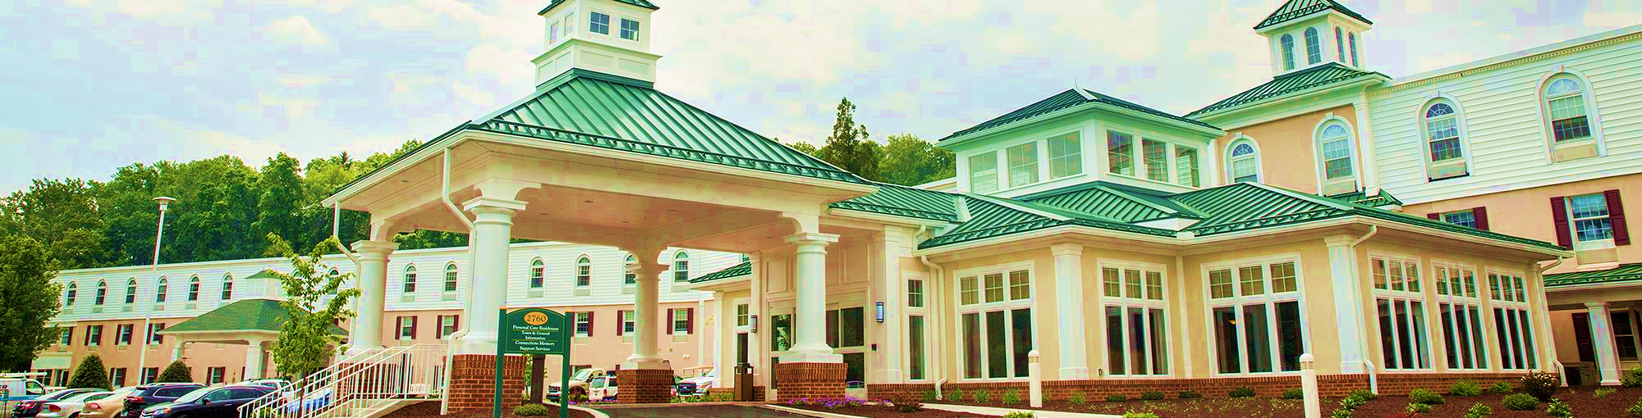
Nursing Homes/Cost of Care
Costs about $7,000-$8,500 per month
Maximize Options
    Stay Home
    Independent Living
    Assisted Living
    Nursing Home
Notes:
Clear Slide
Minutes Per Slide:________

Slide 100

How to Pay for Care
You pay
LTC Insurance Pays
Government Pays
Handouts: Asset Protection Analysis; LTC Partnership Policies; 7 Costliest Mistakes to Avoid When a Spouse Enters a Nursing Home
Notes:
Handouts:
Asset Protection Analysis → scenario/letter to Financial Advisor, asking to analyze the risk a couple has of losing their assets to a lawsuit, nursing home or other unforeseen liability
LTC Partnership Policies → what is the LTC partnership, frequently asked questions
7 Costliest Mistakes to Make When Entering a Nursing Home → (1) purchasing exempt assets before date of admission, (2) failing to use non-exempt assets to protect the spouse’s income, (3) spending down exempt resources, (4) continuing to spend down after you would qualify for Medicaid, (5) missing opportunities for exempt transfers, (6) having an insufficient POA, (7) not getting expert advice about how to pay for LTC
The Deficit Reduction Act (DRA), which was signed into law on February 8, 2006, included section 6021. This provision authorized states to offer special Medicaid asset disregards for persons purchasing and using qualified private long term care insurance policies -- which have come to be known as 'Partnership' policies.
The Long Term Care Partnership Program is a joint federal-state policy initiative to promote the purchase of private long term care insurance. The Partnership Program is intended to expand access to private long term care insurance policy to pay for long term care services.
Purchasing a Partnership-qualified (PQ) long term care insurance policy provides an added benefit. This benefit is described as “dollar-for-dollar” asset disregard or “spend down” protection. Individuals who purchase a PQ policy 'earn' one dollar of Medicaid asset disregard for every dollar of insurance coverage paid on their behalf.
Here's an example. Stephanie buys a PQ policy and needs care one day. Her policy pays out $150,000 of insurance claim benefits. Stephanie earns a Medicaid asset disregard that allows her to keep an additional $150,000 over the asset level she would otherwise have to meet in order to be eligible for Medicaid coverage. The Partnership Program also protects those assets after death from Medicaid estate recovery.
-Hybrid Policies
Minutes Per Slide:________

Slide 101

Government Benefits
Care at Home/Assisted Living
    VA Benefits
    Medicaid Benefits (Waiver Program)
Nursing Home
    Medicaid
Notes:
Minutes Per Slide:________

Slide 102
Special needs planning
Notes:
Clear Slide
Minutes Per Slide:________

Slide 103


As a Parent, you want to:
Protect your children
Ensure they have the best quality of life
Notes:
Read the slide then tell a couple stories about how we try to protect our children from falling and hurting themselves while learning to ride a bike, when falling in love, etc. and how we try to encourage them to get a good job so they can enjoy their lives, with quality.
Transition statement: With children with special needs who are disabled, we have to be more deliberate and take extra measures to ensure their quality of life.
Minutes Per Slide:________

Slide 104

Planning for People with Special Needs
Power of Attorney vs. Guardianship
Testamentary Special Needs Trust
  Leaving $ upon death
Stand Alone Special Needs Trust
  Parent/Grandparent providing support now
Notes:
Testamentary SNT: a special needs trust created inside of a Last Will and Testament which will only become effective when the testator dies; often protecting all the assets from all creditors, to include Medicaid
Stand Alone Special Needs Trust: created and effective while grantor is alive
-- First Party SNT: created by the money from the person with disabilities (i.e. lawsuits, inheritances, savings). Must have a “pay-back” provision to Medicaid upon grantor’s death and may only be able to create and fund if the person is under the age of 65.
-- 3rd Party SNT: created by a person other than the person with disabilities (or their spouse) for the benefit of the person with disabilities. This trust does not have to have a payback to the state upon death. When drafted properly, the funds will not be counted toward Medicaid eligibility.
Seed SNT: A third party trust that is funded with only a small amount of money, but is intended to be the “pool” where anyone who wants to leave the person with disabilities any money (one convenient place) so the person does not lose any government assistance benefits.
Minutes Per Slide:________

Slide 105
Government PROGRAMS
Notes:
Clear Slide
Minutes Per Slide:________

Slide 106
1. Public Assistance –
GA Department of Human Services
Programs Offered:
Energy Assistance
Food Stamps
Waiver Programs for kCommunity Living
Medicaid or medical sassistance
Eligibility:
Asset Tested
< $2,000 for single; $3,000 married couple
Income Tested
0-18, Based on Parental Income
18+, Based on Special Needs Person’s Income; sliding scale per household members
Notes:
Clear Slide
Minutes Per Slide:________

Slide 107
2. Social Insurance – Social Security
Eligibility:
Diagnosed Disability
Income earned
<$814 (ind)/$1,211 (c)/month
Assets <$2000/$3,000
Benefits:
Social Security Disability Insurance (No Eligibility Limits)
SSI
Medicare
When to apply:
Death of a parent
Parent becomes totally disabled
Parent Retires (62-65)
Person with a disability has worked at least 6 quarters
Notes:
Clear Slide
Minutes Per Slide:________

Slide 108
Guardianship &
Conservatorship
A Review
Notes:
Clear Slide
Minutes Per Slide:________

Slide 109

Guardianship/Conservatorship
All Adults 18+ are presumed to be competent
Notes:
Clear Slide
Minutes Per Slide:________

Slide 110
Guardianship/Conservatorship Process
Petition
Hearing
Medical testimony
Attendance of alleged incapacitated person
Notes:
Minutes Per Slide:________
Explain the process of guardianship
Bonding- must have bonding in place ahead of time
Annual reporting
POA can avoid this process all together
Resource (York County Orphans Court)
Handout
Petition
Consent of ind. to serve
Consent of corp. fiduciary
preliminary decree
citation
Section 5513- emergency guardianship- an emergency order appointing an emergency guardian of the person may be in effect for up to 72 hours. If the emergency continues the emergency order may be extended for no more than 20 days from the expiration of initial emergency order.

Slide 111
options
Notes:
Clear Slide
Minutes Per Slide:________

Slide 112

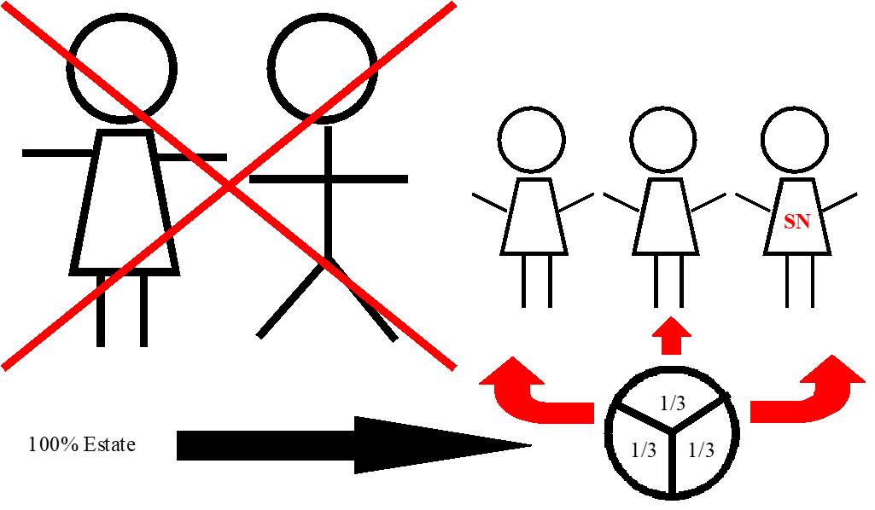
Option 1
Outright Gift
Inheritance could exceed the SSI eligibility limit of $2,000
Notes:
Clear Slide
Minutes Per Slide:________

Slide 113
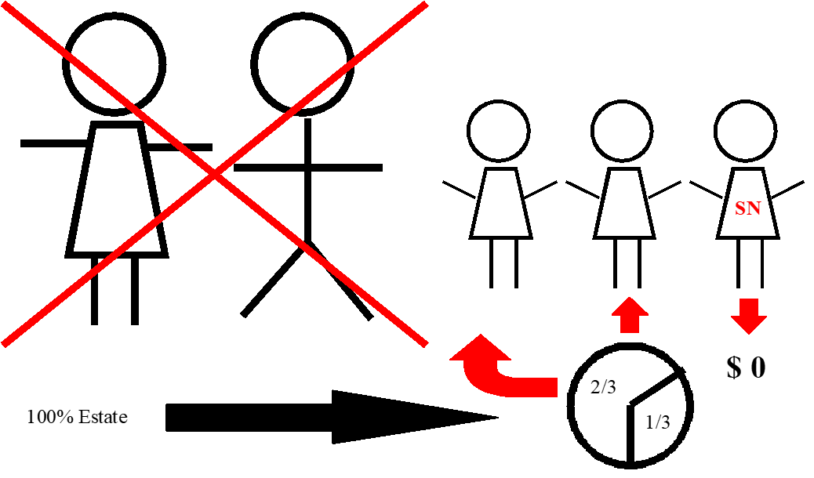
Option 2
“Morally Obligated Sibling”
No Legal Ties, No Guarantees, Death, Divorce, Bankruptcy
Notes:
Minutes Per Slide:________
Clear Slide

Slide 114
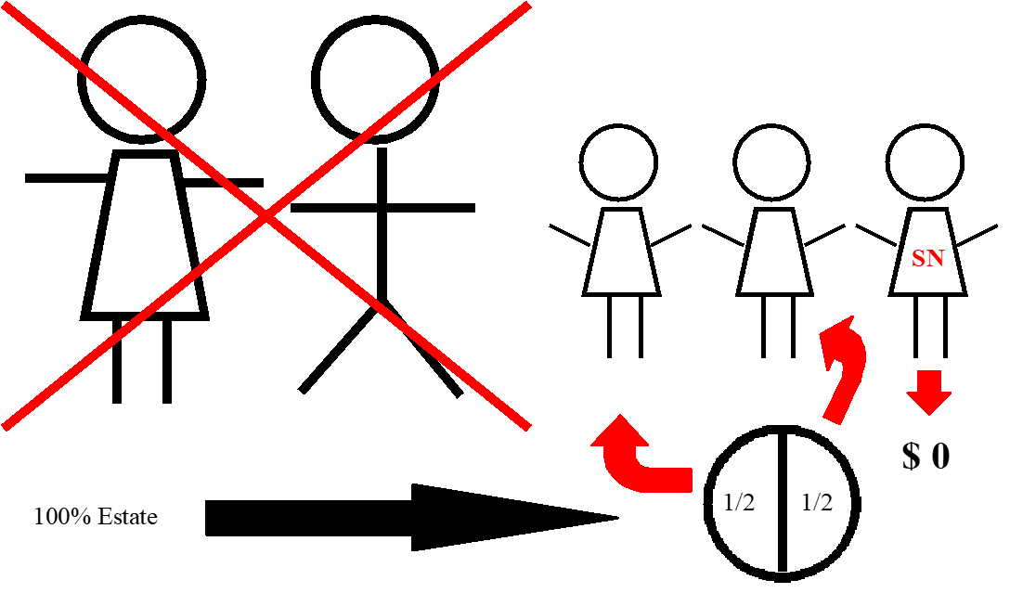
Option 3
Disinherit
Special Needs Child does not receive a share of the estate
Notes:
Minutes Per Slide:________
Clear Slide

Slide 115

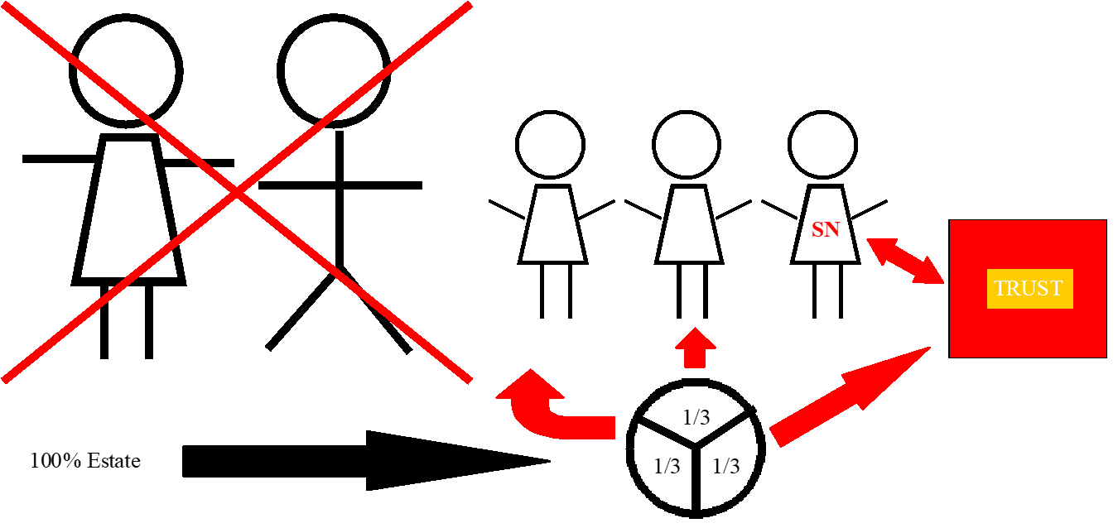
Special Needs Trust
If a trust is written properly, all government programs stay intact! Special Needs Child can indirectly receive a portion of the estate.
Notes:
Minutes Per Slide:________
Clear Slide

Slide 116

Support Trust
The purpose of the trust is to establish basic payments for “support“ and necessities –
  Food
  Clothing
  Housing
  Medical
  Education
  Any amount over $2,000 in this type of trust would disqualify the special needs family member from government benefits.
Notes:
Reference HEMS Std.
Minutes Per Slide:________

Slide 117
Special Needs Trust
Also known as Supplemental Trust or Discretionary Trust.
The Distribution amount from the trust is at the sole discretion of the Trustee.
The wording needs to clearly state that the trust fund will supplement governmental benefits and is not intended to replace (supplant) what the government is providing for the special needs person.
Notes:
Clear Slide
Minutes Per Slide:________

Slide 118

Special Needs Trust
NOT FOR SUPPORT – Enhances Government Benefits
TRUSTEE HAS SOLE DISCRETION FOR DISBURSEMENT OF FUNDS FOR:
  Unreimbursed Medical
  Vacation Opportunities
  Visit Family Members
  Camps
  Private Vocational Training
Notes:
Minutes Per Slide:________
Clear Slide

Slide 119
Choice of Timetable
When Trust Can Take Place
Living Trust
Testamentary Trust
Notes:
Minutes Per Slide:________
Clear Slide

Slide 120
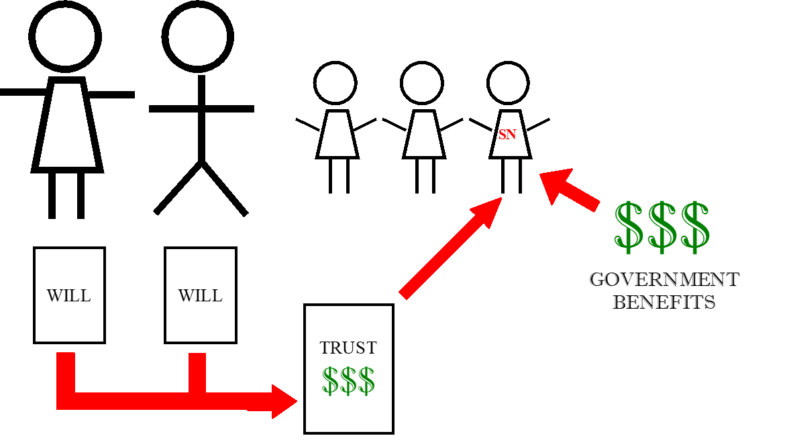
Option 1
Living Trust
(Inter vivos Trust): In existence today
Notes:
Minutes Per Slide:________
Clear Slide

Slide 121
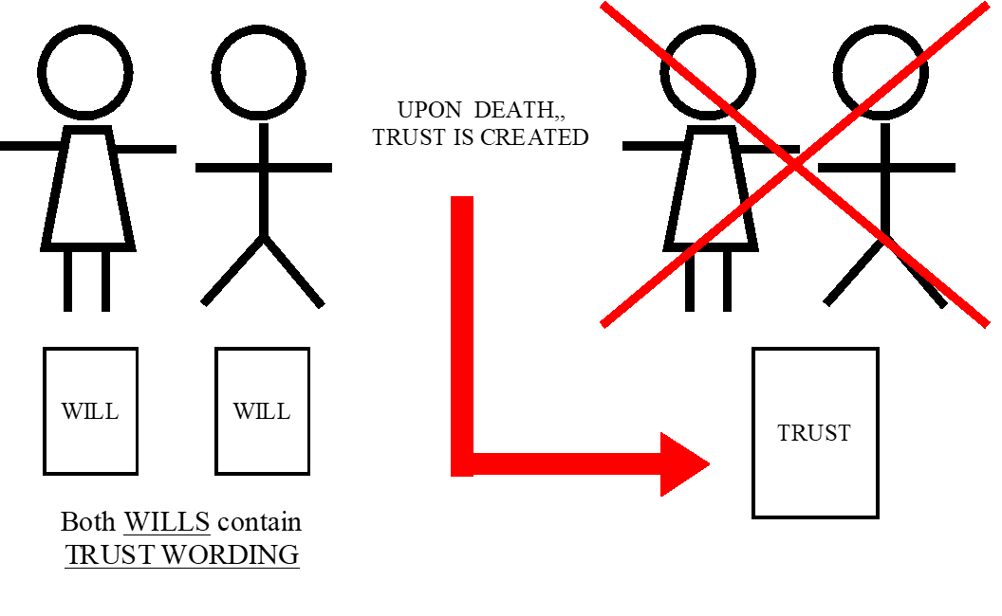
Option 2
Testamentary Trust
Not in existence until your death
Notes:
Minutes Per Slide:________
Clear Slide

Slide 122
What can be used if the person receiving benefits has more than $2,000?
1st party Pay-Back Trust
  d(4)a Trust
ABLE Account
Pooled Trust
Notes:
Minutes Per Slide:________
Clear Slide

Slide 123
Third Party Special Needs Trust
Created using the parents’ assets, or another person other than the individual receiving benefits, as part of an estate plan; distributed by a Will or irrevocable trust
Notes:
Third Party Special Needs/Supplemental Needs Trust is a trust created by someone other than the disabled person. Usually a Parent, Grandparent, etc.
Can create a Will with SNT provisions in case
Ask who has minor heirs/ disabled heirs
Incorrect – Nobody has an heir until death.
We must all plan for it.
Minutes Per Slide:________

Slide 124
Self-Settled Special Needs Trust/
AKA Pay-Back Trust
Generally created by a parents, grandparent or legal guardian using the child’s assets to fund the trust. If the assets remain in the trust after the beneficiary’s death, a pay-back to the state is required.
Now, can be created by the disabled individual if he or she has capacity to sign.
Notes:
Self Settled- A trust created with the funds of the disabled individual. If drafted properly the money will not disqualify the individual with a disability during his/her lifetime but the money left after death must go to the state
Minutes Per Slide:________

Slide 125
ABLE Accounts
Accounts allowed to be set up in Georgia to continue benefits and pay for qualified disability expenses
Notes:
Clear Slide
Minutes Per Slide:________

Slide 126
 | ABLE ACCOUNT | SPECIAL NEEDS TRUST
Onset of Disability | Qualifying disability exists prior to age 26 | No requirement
Age of Beneficiary | No requirement | 1st Party: Trust established prior to age 65 3rd Party: No requirement
Who May Establish | Beneficiary, parent, guardian, agent | 1st Party: Parent, grandparent, guardian, court, and now the beneficiary thanks to the Special Needs Trust Fairness Act 3rd Party: Anyone except beneficiary 1st Party Pooled Trust: Beneficiary, parent, grandparent, guardian, court
Number of Accounts | One per beneficiary | Unlimited
Fees | Financial institution fees | Attorney & trustee fees
Contribution Limits | $15,000/year (federal gift tax limit); SSI payments suspended when account assets total $100K | Unlimited
Investment Options | Investment strategies may be changed twice annually | No restrictions
Valid Distributions | Broadly defined “disability expenses,” including basic living expenses | Any expense for sole benefit of beneficiary, with certain implications for distributions for food and/or shelter
Taxes | Earned income is tax-free and distributions are not taxed as long as they are used for Qualified Disability Expenses | First Party Trusts are generally treated as grantor trusts and income is taxable to the beneficiary, subject to the beneficiary’s own deductions, exemptions, etc. Often, the amount of income generated by trust holdings will be below taxable limits. Third Party Trusts can use as variety of planning strategies to minimize taxes that may be due. Proper drafting and advice will help to minimize tax concerns.
Medicaid Payback Upon Death of Beneficiary | Remaining funds must reimburse state for Medicaid benefits | 1st Party: Remaining Funds must reimburse state for Medicaid benefits 3rd Party: No payback
Notes:
Clear Slide
Minutes Per Slide:________

Slide 127
Pooled Trust
Trust using a non-profit agency as the trustee
No payback is required, but the resources must remain in the pooled trust after the death of the beneficiary for the benefit of other persons with disabilities.
Notes:
Pooled Trust – Non-Profit Agencies often have Pooled Trusts – Typically cheaper for family because don’t have to draft complicated agreement. Usually only requires a joinder. Upon death the money must be left in the Pooled Trust for others with disabilities.
Minutes Per Slide:________

Slide 128
What Should I Do Next?
Talk to a qualified attorney to determine what you need for you and your family.
Talk to a qualified attorney to determine if your son or daughter with special needs will need planning now or in the future.
Notes:
Clear Slide
Minutes Per Slide:________

Slide 129
Caregiver support
Independent Living/Care in Home
Notes:
Clear Slide
Minutes Per Slide:________

Slide 130

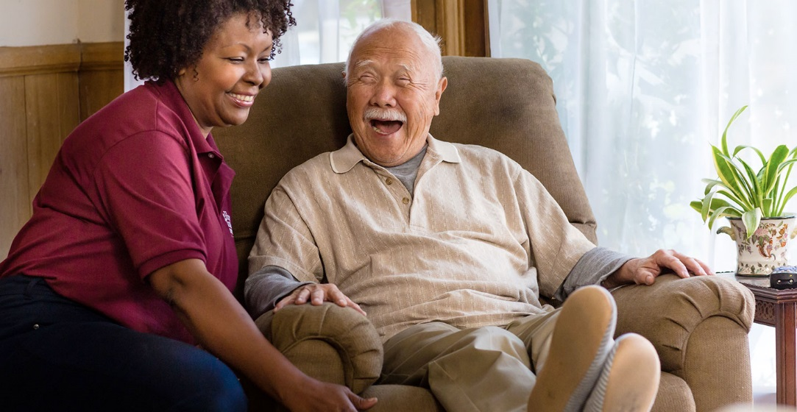
Caregivers
Two classes of caregivers
    Family
    Third Party
Handout: Caring for Elderly Parents: Real-Life Stories
Notes:
Handout:
Caring for Elderly Parents: Real-Life Stories → 3 stories of different family experiences, learning how to choose the best caregiving option
“The average American lives to 79”
“Some 44 million people in the U.S. (that’s about 19% of us) are caring for an adult loved one.”
Minutes Per Slide:________

Slide 131
Caregiver Statistics
About 34.2 million Americans have provided unpaid care to an adult age 50 or older in the last 12 months. [National Alliance for Caregiving and AARP. (2015). Caregiving in the U.S.]
At $470 billion in 2013, the value of unpaid caregiving exceeded the value of paid home care and total Medicaid spending in the same year, and nearly matched the value of the sales of the world’s largest company, Wal-Mart ($477 billion). [AARP Public Policy Institute. (2015). Valuing the Invaluable: 2015 Update.]
Notes:
Latest Statistics we could find and determine accurate.
Minutes Per Slide:________

Slide 132
2017 Care.com Study:
Georgia ranks 26th in family caregivers & the economic value of caregiving
GA
10,700,000
3,103,000
41/week
Number of
Number of
State
State
$3,813.00
Economic
Population
Caregivers
Care
Value per
Month
$11,831,739,000
Total
Value
Economic
Hours
Handout: Challenges for Family Caregivers
Notes:
Handouts:
Challenges for Family Caregivers → obvious and subtle situations that can create tension among caregiving family members (finances, relationships, time)
Minutes Per Slide:________

Slide 133

Caregiver Agreements
An agreement between caregiver(s)and care recipient to provide care and/or lodging for care recipient
Notes:
Must be in writing
Minutes Per Slide:________

Slide 134
Valid Caregiver Agreements
Written
    rebuts presumption done out of love and affection
Fair consideration (compensation)
    for Family Caregiver Agreement, compare services and housing to icommunity rates (local SNFs, ALFs, HHAs)
Specify Services
Length of Services
Executed by both parties
    DHS: wants to see that actual care recipient signed Family iagreement; not POA if POA is also a caregiver
Notes:
Clear Slide
Minutes Per Slide:________

Slide 135

Detailed Expectations of Parties
Accommodations:
    Where provided?
    Bedroom or suite?
    Private bath?
    Use of kitchen/common area?
    Use of garage?
Notes:
Some key provisions that should be discussed and included
Minutes Per Slide:________

Slide 136
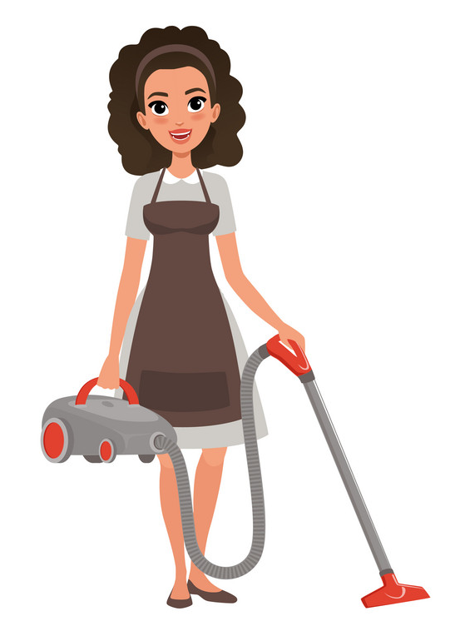


What Services are Included?
Meals
    Included? How many? Different on weekends?
Cleaning
    How frequent?
Laundry
    How often?
Transportation
    Where to? How often?
Financial
    Pay bills? Investments?
Medical
    Is caregiver able to provide and at what level? (e.g. nurse)
    Monitor health?
Vacation
    For both caregiver and recipient—still get paid?
    Alternate caregivers
Notes:
Clear Slide
Minutes Per Slide:________

Slide 137
What Happens If Things Don’t Work Out?
Trial Period?
Money back?
What if caregiver dies and living in child’s home?
    Does spouse take over? (son-in-law)
What if recipient needs to go to facility?
    Services continue at some level? (no duplication)
    What happens to personal property if going to facility?
Notes:
Clear Slide
Minutes Per Slide:________

Slide 138
Compensation
What’s it based on?
    Per hour or lump sum?
    When paid?
    Per hour/Periodic payments (preferably monthly) for services ipreferred for Medicaid—rebuts argument that it is a gift
Reimbursement for caregiver’s use of utilities and gtaxes
    Gas, water, sewage, homeowners/renter’s insurance
    Divide by number of people in home
Wages must be reasonable for the area where services received
Notes:
Clear Slide
Minutes Per Slide:________

Slide 139
Taxes
INCOME TAX:
    Payments to caregiver subject to income tax
      Have 1099 issued (very important for DHS)
    Payments for caregiver may reduce care hrecipient’s income tax liability
      Deductible medical expense if exceeds ___% of adjustable gross income
      Definition of “Medical Expense” is broad
Notes:
Clear Slide
Adjustable Gross Income: currently 10% (will need to consistently update)
Minutes Per Slide:________

Slide 140
Caregiver Agreements Used to Qualify for Benefits
Medicaid Spend Down
    Spend down while waiting to become Medicaid financially eligible, and apply for OPTIONS program while completing Spend Down
    Make lump sum payment even if medically eligible for Medicaid home waiver services, but transfer deemed gift; started clock running on ineligibility period and possible still get OPTIONS benefits
Veterans Benefits
    Personal caregiver agreements legitimate UME and may help qualify vet for VA and attendance benefits
Notes:
Options: under AAA – does assessment to see if qualify
Minutes Per Slide:________

Slide 141
Veterans aid & attendance benefits
Requirements & Rates
Notes:
Clear Slide
Minutes Per Slide:________

Slide 142

Who’s Eligible?
Veteran
Widowed spouse
Dependent or disabled child
Handout: Veteran Benefits General Qualifications
Notes:
Handout:
Veteran Benefits General Qualifications
Minutes Per Slide:________

Slide 143

A. Military Service Requirements
90 days of active duty service
1 day during wartime
Other than dishonorable discharge
Notes:
Clear Slide
Minutes Per Slide:________

Slide 144

B. Care Need Requirements
Need assistance with two or more Activities of Daily Living (ADLs)
    Bathing
    Dressing
    Toileting
    Transferring
    Eating
    Grooming
    Walking
    Taking Medication
Notes:
In ALF we need physician statement
Minutes Per Slide:________

Slide 145
C. Financial Requirements
Limited household assets
      Net worth, life expectancy
      Unreimbursed medical expenses
Countable Income for VA purposes
      Countable vs. Non-countable
Notes:
Limited Household assets: 2021 → net worth limit of $130,773
Social Security SSI
Pension
Retirement
Minutes Per Slide:________

Slide 146
“Maximum” Rates - 2021
Single Veteran | $1,936.50/month | $23,238per year
Married Veteran | $2,295.75/month | $27,549 per year
Widowed Spouse | $1,244.50/month | $14,934 per year
Vet married to Vet | $3,071.75/month | $36,861 per year
Surviving Spouse w/ one Dependent | $1,484.58/month | $17,815 per year
Notes:
Run through examples
2021 MAXIMUM RATES:
Single Veteran: $23,238/year
Married Veteran: $27,549/year
Widowed Spouse: $14,934/year
Vet Married to Vet: $36,861/year
Surviving Spouse w/ one Dependent: $17,815/year
Minutes Per Slide:________

Slide 147
Unreimbursed Medical Expenses
Can affect ability to obtain maximum rate
Examples:
    Assisted living fees
    Independent living fees (if for protective reasons)
    Health insurance premiums
    Co-pays
    Prescriptions
    Hospital bills
Notes:
Clear Slide
Minutes Per Slide:________

Slide 148

Trusts & VA Planning
Notes:
- Refer back to trust conversation
Use wagon to remind room
Irrevocable Non-Grantor Trust
Minutes Per Slide:________

Slide 149
How Do Caregiver Agreements Tie Into Veterans Aid?
Used to count as unreimbursed medical expenses
Notes:
Clear Slide
Minutes Per Slide:________

Slide 150
MIDDAY DEBRIEF
What stood out for you?
What do you want to remember?
What surprised you?
General comments
Notes:
Clear Slide
Minutes Per Slide:________

Slide 151
Medicaid
Long-term Care
Handout: Medicaid Terms of Art Glossary
Notes:
Handout:
Medicaid Terms of Art Glossary → sheet with abbreviations and definitions of key Medicaid terms
Minutes Per Slide:________

Slide 152

Medicaid
Established in 1965 along with Medicare
Federal Program
Administered by states
Notes:
Clear Slide
Minutes Per Slide:________

Slide 153
Medicaid Eligibility Requirement
Citizen, GA resident
65+, blind, or disabled
Medically eligible
Assets < $2,000.00
Notes:
This # will change.
Minutes Per Slide:________

Slide 154

After Qualification
Program pays for nursing facility care
Recipient’s income paid to nursing jifacility, except for:
    $70/month, personal need allowance
    Health insurance premium
    Income to spouse, if applicable
    Other deductions may apply
Notes:
Clear Slide
Minutes Per Slide:________

Slide 155
ALL RESOURCES
APPLICANT (AND SPOUSE)
Exempt
Non-Exempt
(not countable)
(countable)
Notes:
Introduce chart
– Reference that we will build on chart throughout this section
Minutes Per Slide:________

Slide 156
Common Exempt Resources
Residence
Property—Trade or gBusiness
    Essential to Self Support
Non-Business Property
    Essential to Self Support
Household dGoods/Personal Effects
Motor Vehicle
Term Insurance
Life Ins/Burial (up to $10,000 combined)
Burial Plots
Community Spouse gQualified Retirement iiPlan/IRA
Retirement/IRAs when taking RMD
Notes:
Handout:
Burial Cost By County → chart of average burial cost (2018)
This amount will change
Residence Equity Limit: For 2018 through 2025, the acquisition indebtedness limit on the qualified residence indebtedness deduction has been lowered to $750,000 for loans incurred after Dec. 15, 2017, and the separate deduction for home-equity indebtedness has been suspended.
Vehicle of reasonable value → What is reasonable?
Van with handicap lifts, etc. → 75,000 (maybe)
Case by case
Minutes Per Slide:________

Slide 157
Asset Transfers
Exempt
For value
Gifts
Notes:
Clear Slide
Minutes Per Slide:________

Slide 158
Common Exempt Transfers
To spouse, or to another for sole benefit qof spouse
To child if disabled, under 21, or blind
House to caregiver child of applicant
House to caregiver sibling of applicant qwith equity interest in residence
Notes:
Must follow rule:
Caregiver child → must be child
Sibling → must be sibling
You can’t change facts.
Minutes Per Slide:________

Slide 159
Transfers for Value
If legitimate and not exorbitant, no qperiod of ineligibility
Examples: nursing care, living expenses iiprior to admission, legal fees
Purchase of exempt resources
Notes:
Clear Slide
Minutes Per Slide:________

Slide 160

Gifts in General
Definition:
Transfer of asset, by applicant or spouse, for less than fair market value
Period of ineligibility may be imposed if made within look-back period
Notes:
What is a gift?
Paint house → $10,000
Is it a gift? …..Depends
What is FMV of painting a house?
If it is 5,000:
Then 5,000 gift
5,000 FMV transfer
Minutes Per Slide:________

Slide 161
Gifts → Period of Ineligibility
Calculation:
Amount Gifted ÷ Penalty Divisor =
Months & Days of Ineligibility
Notes:
Do the story of how this works & how much $ it can be
Penalty Divisor = $8,517.00/month (2021)
Minutes Per Slide:________

Slide 162


Look-Back Period
Depends on date when application for qbenefits is filed
60 months
    Transfers to trust
    OR
    Transfers to individuals
Notes:
Clear Slide
Minutes Per Slide:________

Slide 163
SINGLE PERSON
ALL RESOURCES
Exempt
Non-Exempt
Up to $_____ or $_____
Spend Down
Nursing Home
Resident
Transfer for Value
Exempt Transfers
Notes:
Will need to annually update “Up to” numbers*
2019: $2,400/$8,000
Building on Chart (do quick overview of how we are building chart)
Minutes Per Slide:________

Slide 164
Community Spouse Resource Allowance (CRSA)
An amount of resources allowed for CS use
Maximum: $130,380.00
Subject to:
    Homeplace and One Car are not countable assets
    Retirement/IRA is not countable if taking RMD
Notes:
2019 CRSA:
Minimum $25,284
Maximum $126,420
Minutes Per Slide:________

Slide 165
Monthly Maintenance Needs Allowance (MMNA)
An amount of income allowed for CS
Equals 150% of federal poverty level for hfamily of two + an excess shelter allowance
Current numbers- 2021:
    Maximum $3,259.50
Notes:
Minutes Per Slide:________

Slide 166
MARRIED COUPLE
ALL RESOURCES (CS & IS)
Exempt
Non-Exempt
Up to $_____/ $_____
CSRA
Annuity?
Available for Spend Down
Transfers:
For value
Exempt
Institutionalized
Spouse
Community Spouse
Nursing Care
Notes:
Walk through of how chart is building
*will need to annually update “Up to” numbers*
2019: $2,400/$8,000
Minutes Per Slide:________

Slide 167
Georgia Gift-Loan Program
DHS will allow a gift & loan between the single nursing home patient and a child.
Example: Wilma dies. Fred goes into Nursing Care. Fred has assets of $500,000.00 and an income of $3,000.00 a month.
  Fred must allocate all of his income to the nursing home (minus $70).
  Fred may gift Pebbles over half of his $500,000.00.
  Fred may loan Pebbles the remaining balance to pay through the penalty the gift created which Pebbles will pay back monthly to the Nursing Homme.
  Fred can qualify for Medicaid and protect over half of his assets!
Notes:
Minutes Per Slide:________

Slide 168
Georgia Gift-Loan Program
DHS will allow a gift & loan between the community spouse and a child.
Example: Fred goes into Nursing Care. Fred and Wilma have combined assets of $500,000.00 and a combined income of $3,000.00 a month.
  Fred may allocate all of his income to Wilma.
  Wilma may keep $130,380.00 of their combined assets.
  Wilma may loan Pebbles the remaining $369,620.00 which Pebbles will pay back monthly to WILMA.
  Fred can qualify for Medicaid without the Flintstones losing any assets!
Notes:
Show case with spouse & CS annuity
Do not get into details here (will show fact pattern in next section → just introduce concept)
Minutes Per Slide:________

Slide 169
Case study
Frantic Mary
Notes:
Clear Slide
Minutes Per Slide:________

Slide 170
Frantic Mary
Mary was referred to our office by a local nursing home because her husband was placed in the nursing home the day before. Mary was frantic that she was going to lose everything that she and her husband had worked for. The social worker at the nursing home advised Mary to come into our office and indicated to Mary that we would be able to protect her assets and allow her husband to remain in the nursing home in the same bed and receive the care that he requires. When I met with Mary, I also reiterated the fact that we would be able to protect 100% of the assets for Mary, but Mary did not believe me. She was concerned that it could not be possible that could be done because she had never heard that before, and she had only heard that she would be allowed to keep half of the assets but no more than $130,380. We were able to protect 100% of Mary’s assets above the $123,600, which was exactly what Mary was hoping for.
Notes:
This example highlights the Georgia gift/loan program. Demonstrate the half-loaf.
Minutes Per Slide:________

Slide 171
Crisis planning
Notes:
Clear Slide
Minutes Per Slide:________

Slide 172
Pre-planning
Crisis Planning
Notes:
Refresh recollection of V and what that means (now we are on the right side of the V)
Minutes Per Slide:________

Slide 173
How Medicaid Works With Trusts
100% protected with pre-planning
Notes:
Outside of 5 years → 100%
4 years → about 90%
3 years → about 75-80%
Why do we say about?
Depends on actual cost of care
Depends on person’s income
Minutes Per Slide:________

Slide 174
Medicaid Crisis: Spouse
Nursing Home
    Gift/Loan Planning – lose nothing
Notes:
Show use of annuity, 100% protected
Do walk-through of how use is the same for NH & Waiver
Minutes Per Slide:________

Slide 175
Medicaid Crisis: Single/Widow/Widower
Nursing Home
    Gift/Loan Planning – save over half
Notes:
Show use of annuity 50% protected
Show limitation of ability to protect assets in PA due to waiver limit
Minutes Per Slide:________

Slide 176


Pre-Planning vs. Crisis Planning
Notes:
Difference between Pre-Plan and Crisis
Minutes Per Slide:________

Slide 177

Pre-Planning
How do we plan ahead to protect assets?
How long do we need to make pre-planning worthwhile for your family?
Notes:
Laws could change
Minutes Per Slide:________

Slide 178
Crisis Plan for Married Couple
What happens to assets if the community spouse needs care later?
Notes:
Assets are only protected for CS from IS
Trust provides guaranteed result
Minutes Per Slide:________

Slide 179
AFTERNOON DEBRIEF
What stood out for you?
What do you want to remember?
What surprised you?
General comments
Notes:
Clear Slide
Minutes Per Slide:________

Slide 180
Death of a loved one
Organ Donation, Autopsy Rights, Handling Estate Assets & Administration
Notes:
Handouts:
Tips for Survivors → immediate actions to take, what not to do, what needs to be done as soon as possible, taxes
Burial Cost by County → chart of average burial cost (2019)
Minutes Per Slide:________

Slide 181
What Survivors Need to Do
Notify relatives, employers, clergy
Determine if autopsy or organ donation hare issues
Check for Will
Find out assets and date of death values
Contact Legal Counsel
Notes:
Clear Slide
Minutes Per Slide:________

Slide 182
Organ donations
And Autopsy Rights
If not identified on your driver’s license, go to Donate Life America (registerme.org) to be entered in the national registry.
Handout: Don’t Throw Out Your Organ Donor Card After 65
Notes:
Handout:
Don’t Throw Out Your Organ Donor Card After 65 → Examples of transplants from living and deceased donors over 65, doctor’s opinion on the success and need for donors
“’Now we can successfully transplant someone in his 60’s or 70’s,’ said Dr. Segev. ‘Twenty years ago, that would not have been common.’”
Driver's license or go to Donate Life America (registerme.org) to be entered on National list
Minutes Per Slide:________

Slide 183

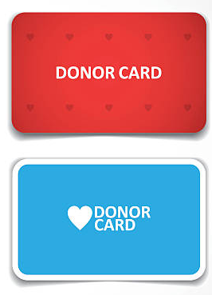
Organ Donations/Anatomical Gifts
Who makes the decision?
Decedent prior to death
    Individual of sound mind, 18 years of age or older
    Agent acting under a power of attorney that authorizes it
    Minor 16 years of age or older, provided parent or guardian consents
        As noted on donor card, driver’s license, etc.
Notes:
Clear Slide
Minutes Per Slide:________

Slide 184

Organ Donation/Anatomical Gifts
Who makes the decision?
After Death (if not in above class or available and absent contrary intent in priority)
    Spouse
    Adult son or daughter
    Either parent
    Adult brother or sister
    Guardian of decedent
    Any other person authorized or under obligation to dispose of the body
Notes:
Clear Slide
Minutes Per Slide:________

Slide 185
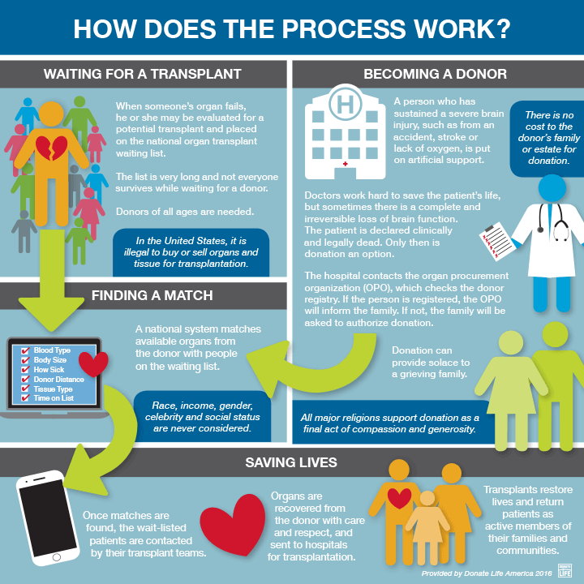
“Deceased organ donation is the process of giving an organ or a part of an organ, at the time of the donor’s death, for the purpose of transplantation to another person.
“At the end of your life, you can give life to others.”
Donate Life America
Notes:
“Deceased organ donation is the process of giving an organ or a part of an organ, at the time of the donor’s death, for the purpose of transplantation to another person. At the end of your life, you can give life to others.” (https://www.donatelife.net/types-of-donation/deceased-donation/)
Minutes Per Slide:________

Slide 186
Organ Donation/Anatomical Gifts
Documenting Anatomical Gift
Will
Other documents
    Signed by donor in presence of two witnesses
Notes:
Be careful in Will
- Wills are not usually looked at until after a person is buried
Minutes Per Slide:________

Slide 187
Organ Donation/Anatomical Gifts
Amendment or Revocation of Gift
If delivered to donee – may revoke or amend by any of the following:
    Signed statement
    Orally before 2 persons and communicated to donee
    Statement during terminal illness or injury to an iattending physician and communicated to donee
    Signed document found on the person or is effects
Notes:
Clear Slide
Minutes Per Slide:________

Slide 188
Organ Donation/Anatomical Gifts
If not delivered to Donee
    Any of the above methods
    OR
    Destruction, cancellation, or mutilation of the document and all executed copies
Notes:
Clear Slide
Minutes Per Slide:________

Slide 189
Autopsy Rights
Authorizations (5 different ones)
    Written authorization of decedent during lifetime and written consent of spouse (if any) after death
    OR
    Written authorization by any party decedent designated to take charge of the body for burial and decedent's spouse (if any) after death
Notes:
Clear Slide
Minutes Per Slide:________

Slide 190
Autopsy Rights (continued)
Authorizations
    Written authorization of decedent’s spouse
    If incompetent surviving spouse, or unavailable or does not claim body, or no surviving spouse, then next closest living relative as define by statute:
    If no one else, written authorization of any other relative or friend who assumes custody of body for burial
Notes:
Clear Slide
Minutes Per Slide:________

Slide 191
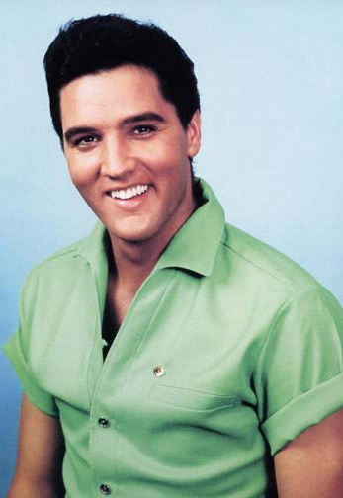
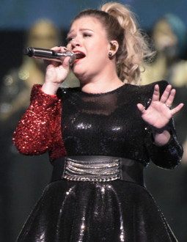

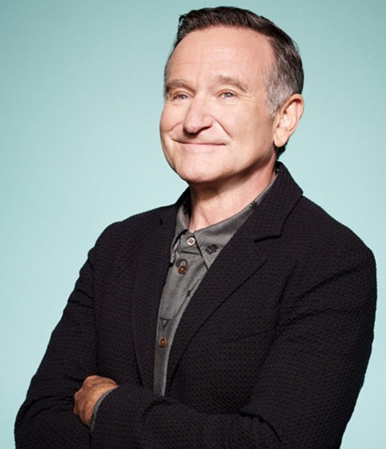
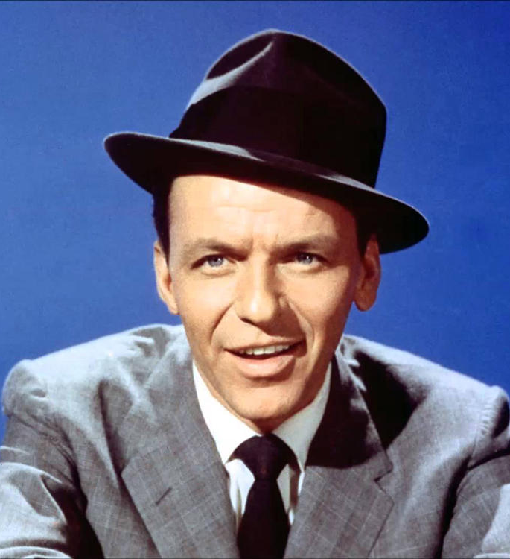





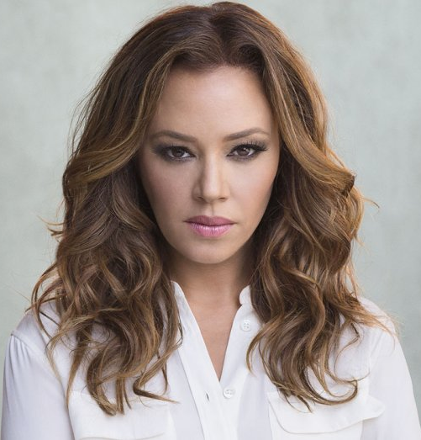

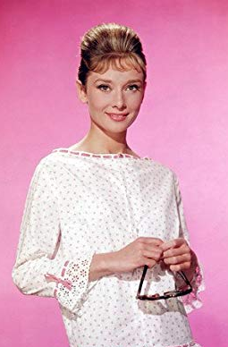



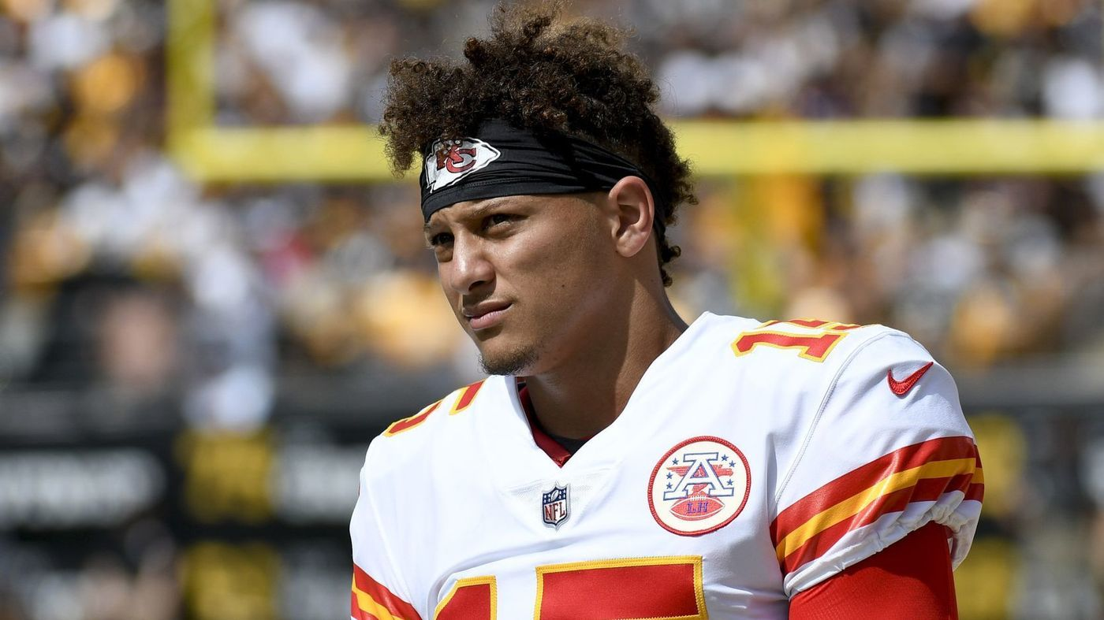


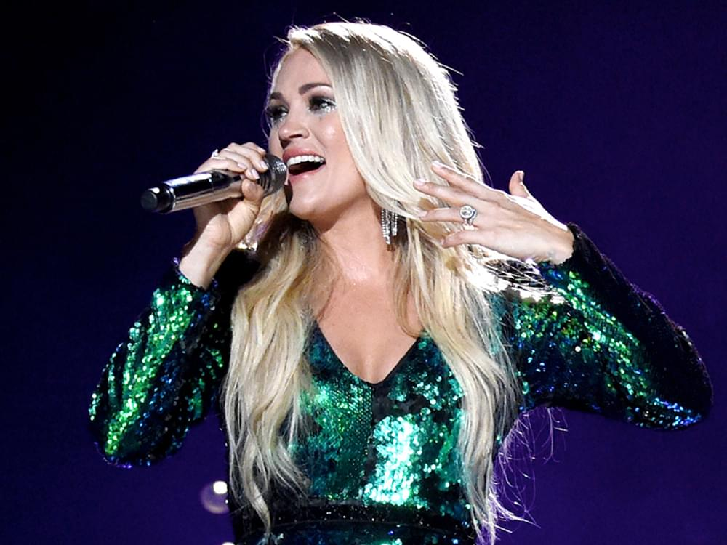
IT’S TIME TO PLAY…
CELEBRITY
Notes:
Celebrity (also known as Celebrities, The Hat Game or Lunchbox) is a party game similar to Charades, where teams play against each other to guess as many celebrity names as possible before time runs out.
Minutes Per Slide:________

Slide 192
Game Rules:
1. There will be 4 rounds.
2. You will receive a set of clues in each round.
3. Use these clues to guess the celebrity.
4. You will only have 60 seconds to guess.
Good Luck!
Notes:
Clear Slide
Minutes Per Slide:________

Slide 193
Died from pancreatic cancer at the age of 76
Became incapacitated
Had no will or trust upon death
Estate is estimated to be worth $80 million
Was the parent of 4 sons, one of whom has special needs
Round I
Notes:
Aretha Franklin: (5 Clues)
Minutes Per Slide:________

Slide 194
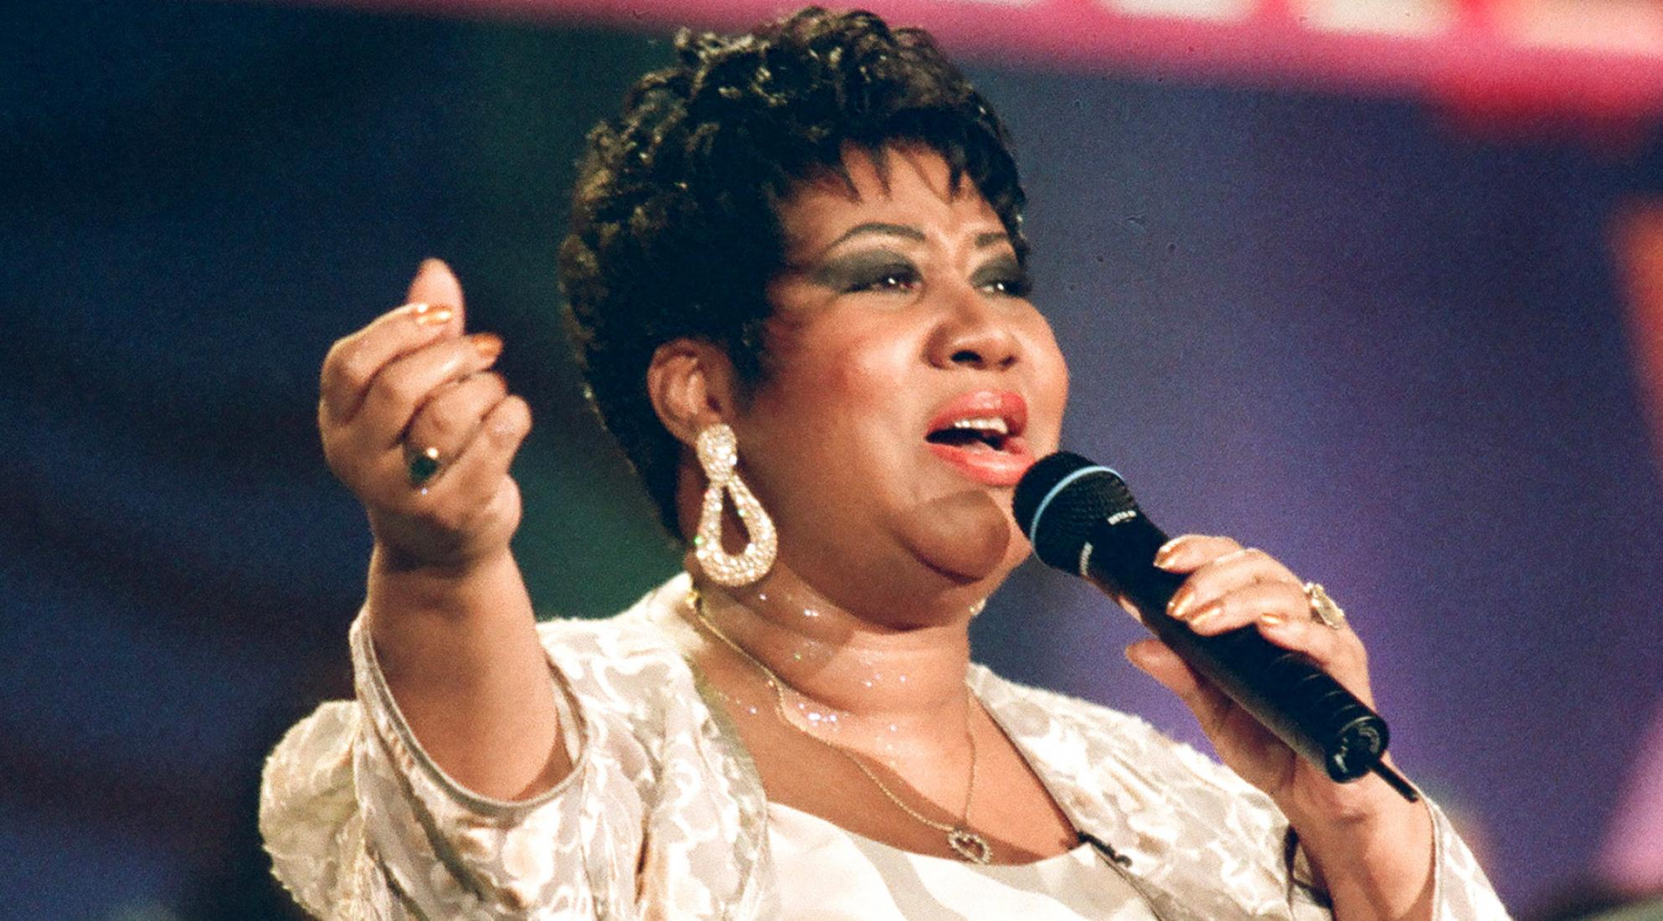
The Celebrity is…
ARETHA FRANKLIN
Notes:
DOD: August 16, 2018
Is the estate settled? NO
One of her lawyers, Don Wilson, said he tried to get her to create a will or trust to keep her estate private and out of probate. She never followed through.
Minutes Per Slide:________

Slide 195
What stood out?
How could this have been prevented?
What should we take from this?
Notes:
Clear Slide
Minutes Per Slide:________

Slide 196
Allegations of murder and elder abuse
2007 and 2011 conflicting documents caused confusion - Is the daughter or wife in charge of making decision?
Suffered from Lewy Body Dementia
Wrongful death lawsuits were filed by the children and countered by the wife
Was at the center of a vicious family feud between his wife and 3 children from a previous marriage
Round II
Estimated $80-100 million estate
Notes:
Casey Kasem: (6 Clues)
Minutes Per Slide:________

Slide 197
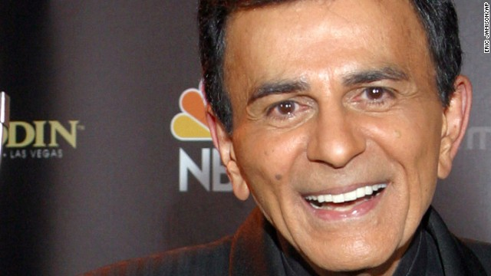
The Celebrity is…
CASEY KASEM
Notes:
the voice and founder of American Top 40 radio show and the voice of Shaggy from Scooby Doo, died on Father’s Day in 2014
Had three children from a prior marriage: Kerri, Mike and Julie
Planned ahead and in the early stages of his illness created a healthcare directive and named his daughter, Kerri, as his agent
Jean, his wife of 34 years, stopped allowing the children to see him
His children were protesting outside of his home
Kerri went to court to seek a conservatorship over his health. Even though she had authority to act under the healthcare directive, his wife would not allow her to do so.
Jean’s attorney responded by declaring that a document signed by Casey in 2011 had given his wife power of attorney, superseding the 2007 conservatorship.
Jean removed him from the nursing home he had been in and took him to Seattle. The court in California, over his wife’s objections, awarded the daughter, Kerri, the right to make his health decisions at that time. Eventually his daughter, citing the terms in his 2007 HCD, approved the termination of his life support when she believed, as was indicated in his directive, that he was devoid of cognitive function and there was no hope of recovery. He died soon after.
In the month before his death, two of his children, Mike and Julie, filed a missing persons case with the Santa Monica police department saying they could not locate their father. Apparently at that time, Kerri was fighting with Casey’s wife over control of his care.
TAKE AWAY: Have an attorney prepare an HCD, Discuss wishes with ALL loved ones, decide who you want to visit you if you become very ill
Minutes Per Slide:________

Slide 198
What stood out?
How could this have been prevented?
What should we take from this?
Notes:
Clear Slide
Minutes Per Slide:________

Slide 199
In 2018, approximately $6 million was spent on legal fees alone
Since there were no known children and no obvious heir, 45 people claimed to be an heir (including siblings, half-siblings, nieces, and even supposed children)
Died from an opioid overdose at the age of 57
Died without an estate plan
Round III
Estimated $200 million estate
Notes:
Prince: (5 Clues)
Minutes Per Slide:________

Slide 200
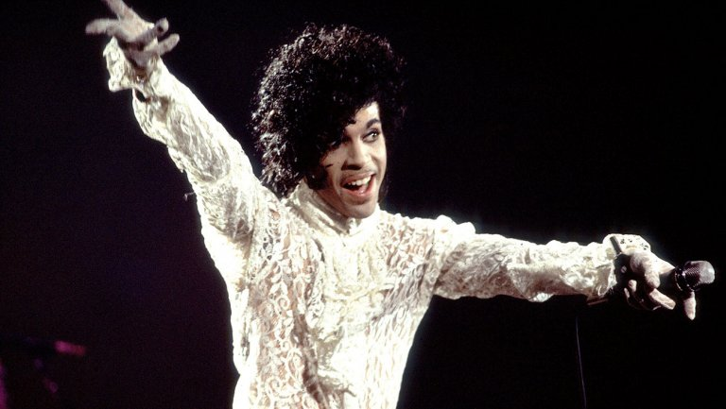
The Celebrity is…
PRINCE
Notes:
DOD: April 21, 2016
Is the estate settled? NO
When an individual doesn’t have a traditional heir or offspring, there are many alternatives available, like nieces, nephews or even charities. The key is informing them while you are still alive of your intentions and goals. This gives them time to prepare and ask the right questions.
Although Prince’s estate had enough liquid assets to pay the estate tax and hasn’t been audited by the IRS, most estates have to sell assets in fire sales to pay the required estate tax. Make sure you have enough liquid assets to pay your estate tax if you’re over the exemption (which in 2019 is $11.4 million per individual for federal tax purposes, although for states that impose taxes, it can be much lower). Immediately paying the tax reduces penalties and interest. A unique tool that provides liquidity at time of death is life insurance, whether it's personally owned or by an irrevocable life insurance trust.
Minutes Per Slide:________

Slide 201
What stood out?
How could this have been prevented?
What should we take from this?
Notes:
Clear Slide
Minutes Per Slide:________

Slide 202
Had a handwritten Will naming her mother as the beneficiary…
By specifically disinheriting her husband, she made sure that the estate only went to her mother
And then met with an attorney to update her estate plan after her marriage, complete with a Will and a Trust
Included a provision stating “I am married to Simon Monjack, who I have intentionally left out of this will.”
Married for 2.5 years
Round IV
Tragically died at the age of 32
Notes:
Brittany Murphy: (6 Clues)
American actress/singer: Clueless, Uptown Girls, Just Married
Mention elective share right
– simply by being married in PA can elect against the Will
– would be entitled to 1/3 unless waived in a pre-nup
Minutes Per Slide:________

Slide 203

The Celebrity is…
BRITTANY MURPHY
Notes:
So what did Murphy do right?
She worked with an attorney to create a formal Will and trust, rather than relying on a handwritten Will;
She used a trust, rather than just a Will, to avoid probate court (that is, if she properly “funded” the trust during her life);
She communicated with her loved ones about her intent and where to find her documents, so there wasn’t confusion and dissension after she passed;
She updated her documents after getting married; and
She used specific language to make sure her money passed to her mother and not her husband.
Minutes Per Slide:________

Slide 204
What stood out?
What was successful?
What should we take from this?
Notes:
So what did Murphy do right?
She worked with an attorney to create a formal will and trust, rather than relying on a handwritten Will;
She used a trust, rather than just a Will, to avoid probate court (that is, if she properly “funded” the trust during her life);
She communicated with her loved ones about her intent and where to find her documents, so there wasn’t confusion and dissension after she passed;
She updated her documents after getting married; and
She used specific language to make sure her money passed to her mother and not her husband.
Minutes Per Slide:________

Slide 205
Handling Estate Assets & estate administration
An Overview
Notes:
Clear Slide
Minutes Per Slide:________

Slide 206
Handling Estate Assets & Estate Administration
Testate Estate | Intestate Estate
Die with Will Will needs to be probated to distribute some or all of decedent's property | Assets owned by decedent that are not effectively disposed of by Will, operation of law or beneficiary designation pass to his or her intestate heirs
Notes:
Clear Slide
Minutes Per Slide:________

Slide 207
Handling Estate Assets & Estate Administration
Important Issues:
What was the date of death?
    Triggers potential due dates
Who are decedent’s survivors and are they entitled to assets of decedent?
Married at time of death?
    Potential year’s support issue
Notes:
Handout:
Intestate Descent in Pennsylvania → flow chart of estate share
Minutes Per Slide:________

Slide 208
Handling Estate Assets & Estate Administration
Divorced?
Ends former spouse’s right to year’s support
    includes pending divorce actions
Ends former spouse’s right to beneficiary designated assets in his/her name provided actually divorced
Exception court orders certain assets to former spouse
Notes:
Clear Slide
Minutes Per Slide:________

Slide 209

Handling Estate Assets & Estate Administration
Kids?
Minors?
Disabled?
Predeceased kids?
If no spouse and no kids, then who is dentitled to assets?
Notes:
Often court involvement in these scenarios
- Highlight states rules VS your own rule book
Minutes Per Slide:________

Slide 210



Handling Estate Assets & Estate Administration
What are the assets?
Three categories:
    Personal property (including vehicles, boats, etc.)
    Real property
    Intangible personal property (bank accounts, investment iaccounts, sticks, bonds, life insurance, annuities)
Handout: How to Spare Your Heirs a Battle Over Your Estate
Notes:
Handout:
How to Spare Your Heirs a Battle Over Your Estate → dangers and examples of family members fighting over non-title property, investing time and thought onto how to distribute personal possessions, make a list, methods for distribution
“’The biggest estate-planning mistake is that people think it’s only about the money…when it comes to personal possessions [people] say, ‘It’s just stuff.’ In fact, such ‘stuff’—the legal term is ‘non-titled property’ –is often the biggest source of unhappiness among families.’”
Minutes Per Slide:________

Slide 211
Handling Estate Assets & Estate Administration
What are the date of death values for the assets?
    Important for valuation and tax purposes
Notes:
Clear Slide
Minutes Per Slide:________

Slide 212
Handling Estate Assets & Estate Administration
How are assets titled?
    Decedent's name alone?
    What assets?
    How much?
Beneficiary designated
    Joint, TOD, or POD?
    What assets?
    How much?
Notes:
Clear Slide
Minutes Per Slide:________

Slide 213

Handling Estate Assets & Estate Administration
Determine whether need to open estate/if Will needs to be probated
Notes:
Anything in a person’s name alone with no beneficiary must go through Probate
Minutes Per Slide:________

Slide 214
Handling Estate Assets & Estate Administration
Is Will valid?
Testamentary capacity
    18 or older, of sound mind
Testamentary Intent
Positive disposition of assets
    In writing signed by decedent at the time of death
    Note absence of witnesses for Will validity
Validity requirements not same as probate grequirements
Notes:
Can be holographic → handwritten
Minutes Per Slide:________

Slide 215
Handling Estate Assets & Estate Administration
Probate of Will
Initiated by person named executor dappearing before Probate Court
Must supply Probate Court with:
    Original Will
    Petition for Probate/Letters Testamentary
    Pay Court’s fee for probate of Will
Notes:
Must present original Will
Grandson Story
Could not prove what happened to original even though we “know”
Minutes Per Slide:________

Slide 216
Handling Estate Assets & Estate Administration
Unless Will is “self-proved”
    The decedent and two witnesses to the Will attest to their signature before a notary at time of signing)
    Two witnesses must prove the signature of the decedent
Will signed by decedent
    Subscribing” witnesses preferred over “non-subscribing” witnesses.
Will signed by maker or by another
    Must be done in the presence of two witnesses who sign their names to the Will in decedent’s presence a/k/a subscribing witnesses
Take-away: Have it be self-proving and avoid problems
Notes:
Clear Slide
Minutes Per Slide:________

Slide 217

Handling Estate Assets & Estate Administration
Get Short Certificates:
    Documentary evidence for Executor of Will (or Administrator of intestate estate) evidencing that person’s authority to act
    Needed to obtain date of death values, close accounts, transfer assets
Notes:
Short certificates → Like Willie Wonka’s Golden Ticket → allows executor to step in shoes of testator
Minutes Per Slide:________

Slide 218
Handling Estate Assets & Estate Administration
Legal Advertising:
    Do ASAP because personal representative may distribute assets without liability for any claims of which the personal representative was not given notice within one year after the first complete advertisement.
Notes:
Shows why we should advertise
Minutes Per Slide:________

Slide 219
Handling Estate Assets & Estate Administration
Notice of Estate Administration:
3 months of date of death
        All Will beneficiaries
        Spouse and children even if not named in Will
        All intestate heirs so entitled if no Will
File Inheritance Tax Return
        9 months from date of death
Notes:
Clear Slide
Minutes Per Slide:________

Slide 220
Handling Estate Assets & Estate Administration
File Inventory
    Earlier of filing inheritance tax return or filing accounting
Distribute Assets
    Cash or in-kind (stocks, IRAs)
    IRAs: Objective to stretch payments over longest possible period of time to defer income tax to beneficiary
Notes:
Clear Slide
Minutes Per Slide:________

Slide 221
Handling Estate Assets & Estate Administration
Close Estate:
Court accounting
OR
Family agreement
Notes:
Most of the time → done by family agreement
Minutes Per Slide:________

Slide 222
Handling Estate Assets & Estate Administration
Trust Administration
Revocable Trust
    No later than 30 days after trustee of revocable trust learns that idecedent who had a trust died, must send notice to:
      Personal Rep. of probate estate, if any
      Spouse, if any
      Children, if any
      Trust beneficiaries
    Within 30 days of notice of date of death notice only to beneficiaries
    Creditors can still make a claim against revocable trust after decedent dies by notifying personal representative of testate estate or intestate estate or, if none, then trustee must advertise notice of estate administration
Notes:
Clear Slide
Minutes Per Slide:________

Slide 223
Handling Estate Assets & Estate Administration
Tax Considerations
Georgia does not currently have an Estate Tax
Federal Estate Tax:
    Assets over $11,700,000taxed at rate of up to 40%
Final Income Tax Return for Decedent:
    Due: April 15th
Notes:
Minutes Per Slide:________

Slide 224
Handling Estate Assets & Estate Administration
Will Contests
Does not suspend the powers and acts of iipersonal representative of estate
Must have standing to appeal
Grounds for contesting:
    Testamentary capacity
    Undue influence
    Must prove by clear and convincing evidence
Notes:
Review of Testamentary Capacity from earlier (show very low bar)
Undue Influence: put in the elements in PA to prove undue influence
Minutes Per Slide:________

Slide 225
What is Undue Influence?
Must prove three elements:
a person in a confidential relationship with the testator
received a substantial benefit
from a testator who had weakened intellect at or around the time the Will was executed.
Notes:
Section II.D of Wills and Trusts Contests in PA document
The most common basis upon which to contest a Will or trust is undue influence. An allegation of undue influence is that someone close to the testator benefited from a change in the distribution scheme by persuading the testator, while in a state of weakened intellect, to make the change. To make out a prima facie case of undue influence, the contestant must show all of the above elements by clear and convincing evidence.
If clear and convincing evidence establishes these elements, then the burden of proof shifts to the proponent to demonstrate, by clear and convincing evidence, a lack of undue influence.
Note that “weakened mentality as relevant to undue influence need not amount to testamentary capacity ... for the particular mental condition of the testatrix on the day she executed the will is not as significant when reflecting upon undue influence as it is when reflecting upon testamentary capacity.” Estate of Lakatosh, 656 A.2d 1378, 1384 (Pa. Super. 1995).
Minutes Per Slide:________

Slide 226
Will and Trust Contests in GA
Standing
Grounds upon which to challenge a Will or trust
      Lack of capacity
      Improper form of execution; revocation
      Problems with authenticity
      Undue influence
Procedure and time limits
      Will
      Revocable Trust
Protecting against contests
      Warning signs
      Meet with the testator alone
      Assess and document capacity
Notes:
Minutes Per Slide:________

Slide 227
DIGITAL ASSETS
Safeguarding
Handouts: Digital Assets After Death; What Happens to Your Facebook Profile After You Die?
Notes:
Handouts:
Digital Assets After Death → chart of common digital assets (Facebook, Google, Amazon), and what you can do with each of them after death
What Happens to your Facebook profile after you die? → begin with an paper-based inventory of usernames and passwords, find and appoint an agent, draw up a digital-assets POA, store your inventory safely
Minutes Per Slide:________

Slide 228


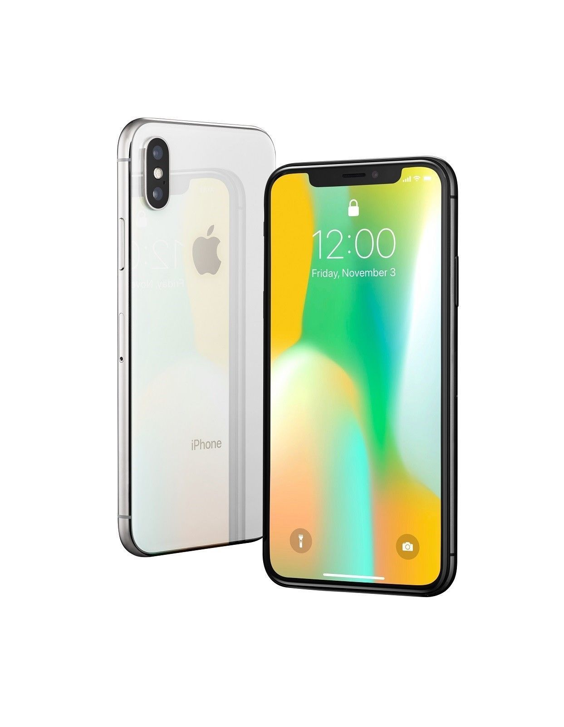

Devices
Desktop computer
Laptop
Smartphone
MP3 Player
Notes:
Clear Slide
Minutes Per Slide:________

Slide 229
Digital Assets – Examples
E-mail Accounts – Gmail, Hotmail, Yahoo!
Social Media – Facebook, Twitter, LinkedIn
Photos – Instagram, Shutterfly
Internet Domains – Amazon, other online commerce accounts
Cloud Storage
Rewards Programs – Airlines, hotel chains
Data on Devices – Hard drive, text messages, app data
Cryptocurrencies – Bitcoin, Ethereum

Slide 230
Pitfalls of Password Sharing
Risk of Fraud
Privacy Concerns
Contractual Limitations – Providers’ Terms of Service Agreements
Federal and State Law Restrictions
Ineffective – Passwords can change, security questions may be asked

Slide 231
Federal Computer Fraud and Abuse Act, 18 U.S.C.§1030
Criminal sanctions for anyone who:
Intentionally accesses a computer without authorization, or
Exceeds authorized access,
And thereby obtains information contained in a financial record of a financial institution, or information from any protected computer

Slide 232
Electronic Communications Privacy Act, 18 U.S.C. §§2701-2712 (also known as the Stored Communications Act) (ECPA/SCA)
The ECPA/SCA prohibits
providers of electronic communication services (e.g. Facebook, e-mail servers, Snapchat, Instagram, etc.) and
Remote computing services (computer storage or processing services, such as financial institutions, e-commerce sites)
from disclosing the contents of its users’ communications
Further prohibits providers of remote computing services from disclosing subscriber/customer records

Slide 233
Exceptions to the ECPA/SCA
Contents may be divulged to an addressee or intended recipient of the communication;
Contents may be divulged with the lawful consent of the originator or addressee, or intended recipient
Records may be divulged with the lawful consent of the subscriber/customer
Note that whether or not to divulge is in the sole discretion of the service provider

Slide 234
Court Interpretations of ECPA/SCA
This is a new area of the law, and there are not a lot of cases.
Some courts have held that a fiduciary can provide lawful consent, and some have skirted that issue,
But most courts have held that access is controlled by the provider’s Terms of Service Agreement, because the Act says “may”, not “shall”.

Slide 235
Revised Uniform Fiduciary Access to Digital Assets Act (RUFADAA)
RUFADAA gives a clear hierarchy of instructions for how a person’s digital assets are to be treated should a fiduciary seek access, which may include not only executors after death, but trustees, court-appointed guardians, and attorneys-in-fact.
42 States have adopted this law, including Georgia Georgia Code 53-13-1 et seq.

Slide 236
RUFADAA Summary
Authorizes personal representatives, guardians, agents under Powers of Attorney, and Trustees to access digital records
Specifically permits service providers to provide a system of account management at death or disability, separate from the provider’s user agreement
The account user may provide authorization in a legal document, or if none, then the service provider’s Terms of Service Agreement will control
In the absence of express authority, contents of a communication may not be accessed, though a catalogue (list of communications without the content) may be accessed if necessary
Expressly incorporates fiduciary duties
Custodians that comply with an apparently valid request for access are immune from liability

Slide 237
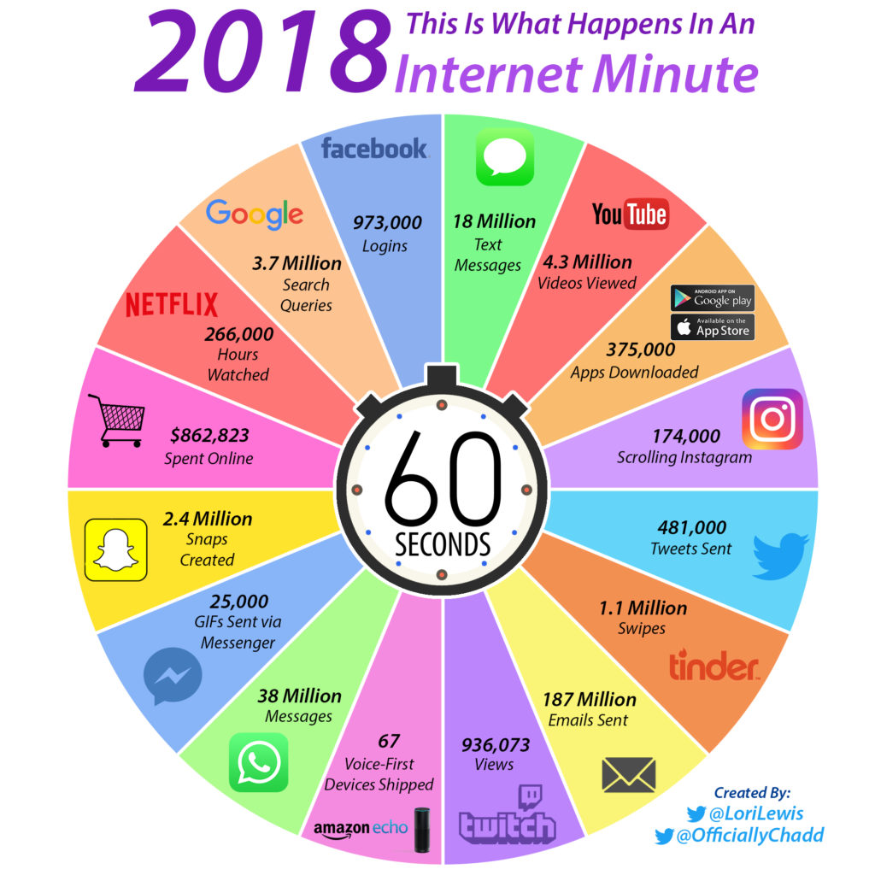
This is what we are doing every 60 seconds!
Notes:
Here are just a few key numbers scaled to a monthly basis, for fun:
42,033,600,000 Facebook logins
159,840,000,000 Google searches
1,641,600,000,000 WhatsApp messages sent
8,078,400,000,000 emails sent
Minutes Per Slide:________

Slide 238
Rights
Ownership vs. License
Access
Deactivation
Transfer
Notes:
Definitions:
Ownership vs. License:
Owning → a person owns property of something that they create, they are free to do with it what they want for as long as they want
Licensing → to permit the use of something or to allow an activity to take place, the person of ownership has given authorization to another party to do certain things with their property
EXAMPLE: In the case of photography, the license would be for the use and reproduction of the photos taken by a photographer. Licensing terms generally regulate things like the period of time the photos can be used, the ways in which a photograph can be displayed, how many copies of a photograph can be made, where the photograph can be distributed, etc.
A common question clients ask photographers is whether or not they will own the images once a project is completed. From this client’s perspective, they are paying for the images, just like they are paying for their office supplies, computers, and office furniture, so they should own them when the shoot is completed. The answer was always ‘no.’ I would answer by explaining that since I was the creator of the work, I would remain the sole owner, but that I would happily license the images to them.
Access: The ability, opportunity, permission, or right to approach, communicate, enter, pass to and from, or view without interference or obstruction.
Deactivation: Deactivating an account is less drastic than deleting the account. It is temporary in that you’ll have the option to return and reactivate the account.
EXAMPLE: When you deactivate your Facebook account, Facebook hides your Timeline, photos, profile and other content from the rest of the site; it's like you're not even there. Friends can still see messages you sent them before you deactivated your account, but they cannot respond to them. When you deactivate your account, you lose admin privileges for any Facebook pages you run.
Transfer: To remove or convey from one place or person to another. An act of the parties, or of the law, by which the title to property is conveyed from one person to another.
Minutes Per Slide:________

Slide 239
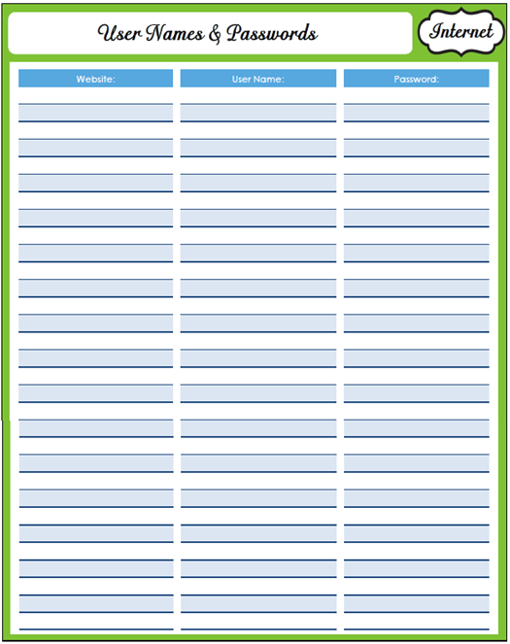
Safeguards
List of usernames & passwords (but store them with your copies of your documents; don’t give them out)
POA language
Will, trust language
Notes:
POA:
10. Digital Assets and Accounts
To access, use, control, modify, delete, and transfer digital devices (e.g., computers, tablets, peripherals, storage devices, mobile telephones, smartphones, etc.), digital assets (e.g., music, photographs, licenses, videos, currency, etc.) and digital accounts (e.g., email accounts, social media accounts, file sharing accounts, financial accounts, etc.) I may own or have a license to use, now or in the future.
Minutes Per Slide:________

Slide 240
Case study solution
Handout: Proposed Solution to Case Study
Notes:
Handout:
Proposed Solution to Case Study → questions are answered, proposed plan is in place for John & Jane Doe
Minutes Per Slide:________

Slide 241
What should I take from today?
Notes:
Clear Slide
Minutes Per Slide:________

Slide 242
collaboration
Notes:
Clear Slide
Minutes Per Slide:________

Slide 243

Collaboration
Workshops/Bootcamp
Asset Protection Analysis
Synergy Meeting
Notes:
Clear Slide
Minutes Per Slide:________

Slide 244
Conclusion
Notes:
Clear Slide
Minutes Per Slide:________

Slide 245
FINAL DEBRIEF
What stood out for you?
What do you want to remember?
What surprised you?
General comments
Notes:
Clear Slide
Minutes Per Slide:________

Slide 246



Thanks for attending!
900 Circle 75 Parkway, Suite 800 • Atlanta, GA 30339
770-933-9009 • www.BrianDouglasLaw.com
Notes:
Clear Slide
Minutes Per Slide:________

